Slide 1
Case report
Acute pancreatitis

Slide 2
Finding of strongly chylosic serum
A blood sample was delivered to the laboratory from a patient complaining of epigastric pain and nausea.
The blood was centrifuged to obtain a serum looking like cream, very strongly chylosed.

Slide 3
Results of the chylosal serum test
Number | Method and result |  | Unit | Note
1. | AST | 0.77 | µkat/l
 | ALT | 0.20 | µkat/l
 | ALP | 2.7 | µkat/l
 | AMS | 7.85 | µkat/l
2. | Glucose | 41.0 | mmol/l | on glucometer (electro-chemical) 42.0 mmol/l
3. | Urea | 6.2 | mmol/l
4. | Creatinine | 118 | µmol/l
5. | Na⁺ | 113 | mmol/l | indirect potentiometry (serum dilution)
 | K⁺ | 4.2 | mmol/l
 | Cl⁻ | 80 | mmol/l
6. | Cholesterol | 31.0 | mmol/l | linear up to 35 mmol/l
7. | Triglycerides | 69.0 | mmol/l | linear up to 23 mmol/l

Slide 4
Which of these results can be released?
AST 0.77 µkat/l; ALT 0.20 µkat/l; ALP 2.7 µkat/l; AMS 7.85 µkat/l
Glucose 41.0 mmol/l
Urea 6.2 mmol/l
Creatinine 118 µmol/l
Na⁺ 113 mmol/l; K⁺ 4.2 mmol/l; Cl⁻ 80 mmol/l
Cholesterol 31.0 mmol/l
Triglycerides 69.0 mmol/l
Note: minerals were measured by indirect potentiometry, other methods by spectrophotometry (enzymes by kinetic, substrates by two-point method).
Notes:
1.
AST
0,77
µkat/l
ALT
0,20
µkat/l
ALP
2,7
µkat/l
AMS
7,85
µkat/l
2.
Glucose
41,0
mmol/l
3.
Urea
6,2
mmol/l
4.
Creatinine
118
µmol/l
5.
At⁺
113
mmol/l
K⁺
4,2
mmol/l
Cl⁻
80
mmol/l
6.
Cholesterol
31,0
mmol/l
7.
Triacylglycerols
69,0
mmol/l

Slide 5
Comment to question 1
For kinetic or two-point methods, both colour and turbidity are subtracted; if there is no objection to linearity, the results can be released.
Mineral values measured by indirect potentiometry cannot be issued (this is so-called pseudohyponatraemia, the concentration is not measured in the aqueous phase but in the whole serum volume including the increased lipid fraction).
We also do not give the concentration of triglycerides as it exceeded the linearity limit.

Slide 6
How would you proceed with a result of triglycerides?
We'll repeat the measurements with diluted serum and multiply the result by the dilution.
We will issue a value > 23 mmol/l (limit of linearity); the result is extremely elevated and quantification is not necessary.

Slide 7
Comment on question 2
It is possible and correct to repeat the measurement with diluted serum and multiply the result by the dilution, but it is unnecessary in terms of evaluating the result and we will therefore issue a triglyceride concentration > 23 mmol/l.

Slide 8
How do you get the correct mineral concentration result?
From the sample after cleaning with LipoClear
Direct potentiometry on an acid-base and mineral testing device
The correct result cannot be determined.

Slide 9
Comment on question 3
According to the company's data, the sample can be used to measure minerals potentiometrically after clearing with LipoClear (essentially a lipoprotein-binding polymer).
Direct potentiometry, i.e. measurement in undiluted serum, gives clinically correct results and is the best; it is a simpler procedure than serum clearance.

Slide 10
Further investigation of the patient
I will repeat the results and add some more:
Method and result |  | Unit
ALP | 2,7 | µkat/l
AMS | 7.85 | µkat/l
Glucose | 41.0 | mmol/l
Urea | 6.2 | mmol/l
Creatinine | 118 | µmol/l
Triglycerides | > 23.0 | mmol/l
Glycated hemoglobin | 49.1 | mmol/mol

Slide 11
Question 4
Elevated amylase, triglycerides and clinical status were suspicious for acute pancreatitis. This was confirmed by computed tomography, sonography showed cholelithiasis, and the problem was preceded by a dietary error.
But how to assess significant hyperglycaemia?
It's probably diabetes, first manifested in acute pancreatitis
It is more of a stress hyperglycaemia in combination with pancreatic damage from inflammation

Slide 12
Comment on question 4
The patient probably had latent diabetes, as her glycated haemoglobin level was already slightly elevated on admission; stress and pancreatic damage exacerbated the condition, which is why such a high glycaemia was measured.
Stress hyperglycaemia itself is not that high.

Slide 13
Case report
Haemolytic anaemia

Slide 14
From the medical history
Boy, 20 months
From physiological pregnancy, delivery at 36 weeks (2 580 g), Apgar score 3-9-9, postpartum adaptation physiological, icterus without phototherapy
Breastfed until 16 months, from 3 months onwards artificial milk formula added
Psychomotor development normal, morbidity minimal

Slide 15
Current disease
10 days subfebrile, signs of mild respiratory infection
Transiently maculopapular exanthema on the trunk
Pallor, fatigue
Hospitalized in the Children's Ward of the Hospital in Karlovy Vary
Due to progressive anaemia (Hb 85 g/l) and icterus (bilirubin 160 µmol/l) he was transferred to the Children's ICU of the University Hospital in Pilsen

Slide 16
Initial laboratory tests – haematology
Method and result |  | Unit
Erythrocytes | 2.27 · 10¹² | l⁻¹
Haemoglobin | 64.0 | g/l
Haematocrit | 0.179
Ery volume (MCV) | 79 | fl
Hb ery | 28.4 | pg
Hb conc. | 359 | g/l
Reticulocytes | 0.041
Leukocytes | 11.3 · 10⁹ | l⁻¹
Platelets | 153 · 10⁹ | l⁻¹

Slide 17
Initial laboratory tests – biochemistry
Method and result |  | Unit
Total bilirubin | 160 | µmol/l
Bilirubin conjugated | 8.4 | µmol/l
AST | 2.16 | µkat/l
ALT | 0.37 | µkat/l
Urea | 9.0 | mmol/l
Creatinine | 34 | µmol/l
CRP | 24 | mg/l
Procalcitonin | 90.2 | µg/l
Lactate | 1.88 | mmol/l
Urine chemically + sediment | protein 2, ketone bodies 2, blood 3, leukocytes 27/µl, erythrocytes 1/µl

Slide 18
What type of icterus is it?
Method and result |  | Unit
Total bilirubin | 160 | µmol/l
Bilirubin conjugated | 8.4 | µmol/l
AST | 2.16 | µkat/l
ALT | 0.37 | µkat/l
Urine chemistry: | protein 2, ketone bodies 2, blood 3, leukocytes 27/µl, erythrocytes 1/µl
Prehepatic
Hepatocellular
Posthepatic
Notes:
1.
AST
0,77
µkat/l
ALT
0,20
µkat/l
ALP
2,7
µkat/l
AMS
7,85
µkat/l
2.
Glucose
41,0
mmol/l
3.
Urea
6,2
mmol/l
4.
Creatinine
118
µmol/l
5.
At⁺
113
mmol/l
K⁺
4,2
mmol/l
Cl⁻
80
mmol/l
6.
Cholesterol
31,0
mmol/l
7.
Triacylglycerols
69,0
mmol/l

Slide 19
Comment to question 1
This is a typical prehepatic icterus (most of the bilirubin is unconjugated, there is no bilirubin in the urine).
The cause is massive haemolysis, which caused the rise in AST activity and blood positivity in the urine (it's free haemoglobin, no erythrocytes are in the sediment).
Prehapatic (haemolytic) icterus should have urobilinogen in the urine; in young children it may not be there – it is formed in the intestine by the reduction of bilirubin by the bacterial flora, and this is not in the intestine in infants.
In a 20-month-old baby, there should be – in the next urine sample there was indeed urobilinogen 2.

Slide 20
What determination best demonstrates massive haemolysis?
AST
LD (lactate dehydrogenase)
Haptoglobin
Alpha₁-antitrypsin
Notes:
1.
AST
0,77
µkat/l
ALT
0,20
µkat/l
ALP
2,7
µkat/l
AMS
7,85
µkat/l
2.
Glucose
41,0
mmol/l
3.
Urea
6,2
mmol/l
4.
Creatinine
118
µmol/l
5.
At⁺
113
mmol/l
K⁺
4,2
mmol/l
Cl⁻
80
mmol/l
6.
Cholesterol
31,0
mmol/l
7.
Triacylglycerols
69,0
mmol/l

Slide 21
Comment on question 2
The most specific is a significant decrease in haptoglobin concentration (it forms a complex with released haemoglobin, which is taken up by RES cells).
Lactate dehydrogenase is less specific, but long persists in the blood (has a long biological half-life).
AST is also released from erythrocytes, but it is also present in other organs (liver, muscles) and the increase is not as pronounced as in LD, so it is not suitable as an indicator of haemolysis.
Alpha₁-antitrypsin is a marker of inflammation.
Finding in our patient:
Haptoglobin < 0.05 g/l
(ref. values 0.7 – 2.5 g/l)
LD 32,47 µkat/l
(ref. values ≤ 2.3 µkat/l)

Slide 22
Blood gas examination (capillary blood)
Parameter | Result
pH | 7.36
pCO₂ (kPa) | 4.7
HCO₃⁻ (mmol/l) | 20.5
BE (mmol/l) | - 3.5
pO₂ (kPa) | 8.0
O₂Hb | 0.94
SO₂ | 0.86
Lactate (mmol/l) | 1.88
Functional saturation = O₂Hb/Hb capable of carrying oxygen
Fractional saturation = O₂Hb/Hb total

Slide 23
What causes the difference between functional and fractional saturation?
Massive haemolysis
Hypoxaemia
Presence of dyshaemoglobin (COHb, metHb)
Rhabdomyolysis

Slide 24
Comment on question 3
During haemolysis, large amounts of haeme are broken down – oxidation of the methine bridge between the 1st and 2nd pyrrole nuclei of haeme produces carbon monoxide.
Our patient's carbonylhaemoglobin concentration was 0.04 (4 %). We would have expected more.

Slide 25
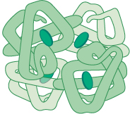
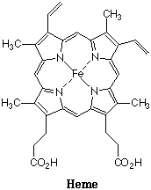
Scheme of haemoglobin breakdown
globin
reutilization for protein synthesis
Fe
CO
hemoglobin
hem
biliverdin

Slide 26
Further fate of the infant
Further laboratory tests:
- positive direct Coombs test
- cold antibodies
Autoimmune nature of haemolytic anaemia treated with steroids i.v.
Antibiotics (cephalosporin 3rd generation) were administered for the finding of inflammatory markers.
A critical drop in haemoglobin led to the need for blood transfusion.

Slide 27
Further fate of the infant
Changes in laboratory parameters are shown in the following graphs.
Signs of haemolysis quickly disappeared (normalization of bilirubin level, smaller drop of LD activity).
The red blood count has stabilized.
There was a steady increase in the concentration of reticulocytes, platelets and leukocytes.

Slide 28
Changes during hospitalization – bilirubin
Bilirubin (µmol/l)
Days of hospitalisation

Slide 29
Changes during hospitalisation – LD
LD (µkat/l)
Days of hospitalisation

Slide 30
Changes during hospitalization – erythrocytes
transfusion
Erythrocytes (· 10¹²/l)
Days of hospitalisation

Slide 31
Changes during hospitalization – haemoglobin
transfusion
Haemoglobin (g/l)
Days of hospitalisation

Slide 32
Changes during hospitalization – reticulocytes
Reticulocytes
Days of hospitalisation

Slide 33
Changes during hospitalization – leukocytes
Leukocytes (· 10⁹/l)
Days of hospitalisation

Slide 34
Changes during hospitalization – platelets
Platelets (· 10⁹/l)
Days of hospitalisation

Slide 35
What is the cause of the increase in leukocyte and platelet concentration?
Uncontrolled infectious complication
Late reactions to haemolysis
Side effect of high-dose steroid therapy
Notes:
1.
AST
0,77
µkat/l
ALT
0,20
µkat/l
ALP
2,7
µkat/l
AMS
7,85
µkat/l
2.
Glucose
41,0
mmol/l
3.
Urea
6,2
mmol/l
4.
Creatinine
118
µmol/l
5.
At⁺
113
mmol/l
K⁺
4,2
mmol/l
Cl⁻
80
mmol/l
6.
Cholesterol
31,0
mmol/l
7.
Triacylglycerols
69,0
mmol/l

Slide 36
Comment on question 4
Inflammatory markers were decreasing, so it was not an uncontrolled infection.
Therapy with high doses of steroids will result in an increase in the concentration of
platelets
leukocytes (decrease in the proportion of adhering neutrophils to the endothelium)
the proportion of lymphocytes decreases
Note: reticulocytosis usually disappears with steroid treatment

Slide 37
Changes during hospitalisation – CRP
CRP (mg/l)
Days of hospitalisation

Slide 38
Changes during hospitalization – procalcitonin
Procalcitonin (µg/l)
Days of hospitalisation

Slide 39
On admission, normal leukocyte count, slightly elevated CRP concentration, extreme procalcitonin
What to think of the result?
Definitely a sign of sepsis
It may be a non-specific reaction
Notes:
1.
AST
0,77
µkat/l
ALT
0,20
µkat/l
ALP
2,7
µkat/l
AMS
7,85
µkat/l
2.
Glucose
41,0
mmol/l
3.
Urea
6,2
mmol/l
4.
Creatinine
118
µmol/l
5.
At⁺
113
mmol/l
K⁺
4,2
mmol/l
Cl⁻
80
mmol/l
6.
Cholesterol
31,0
mmol/l
7.
Triacylglycerols
69,0
mmol/l

Slide 40
Comment on question 5
Procalcitonin indicates sepsis or septic shock
However, we also observe a rise in:
severe surgeries, injuries, burns
cardiogenic shock
severe kidney or liver failure
autoimmune diseases
rhabdomyolysis
D-dimer elevations (repeatedly > 5.0 mg/l FEU) were similarly nonspecific – no evidence of thromboembolism

Slide 41
Infection not proven
The patient underwent culture from all possible body orifices and a comprehensive serological examination for the presence of the whole spectrum of viral infections.
Positive only for Hemophilus influenzae in the swab from the throat.
Thus, the positive markers of inflammation did not indicate a true infection, but a non-specific reaction to massive haemolysis of autoimmune aetiology.
The CRP level was only slightly elevated (maximum 25 g/l), interleukin 6 was 2.39 ng/l (reference values 2 – 15 ng/l).

Slide 42
Final diagnosis
Child discharged after seven days of hospitalization in good condition, on oral steroids, with a diagnosis of:
Autoimmune haemolytic anaemia

Slide 43
Case report
Hereditary haemochromatosis

Slide 44
Medical history and current disease
50-year-old man, treated for more than 20 years for porphyria cutanea tarda with photosensitivity of the hands
admitted to the internal medicine clinic for newly diagnosed diabetes (fasting glycaemia 15.3 – 19.6 mmol/l, glycated haemoglobin 82.3 mmol/mol), weakness and weight loss of 7 kg in 4 months
Insulin therapy started, attempt to switch to oral antidiabetic therapy unsuccessful.
Pathological indicators of iron metabolism were found.

Slide 45
Laboratory tests – indicators of iron metabolism
Method and result |  | Normal values | Unit
Iron | 38.9 | 9 – 34 | µmol/l
Transferrin | 1.95 | 2.0 – 3,6 | g/l
Transferrin saturation | 79.8 | 20.0 – 50.0 | %
Ferritin | 926 | 30 – 284 | µg/l

Slide 46
Next procedure – search for the cause
Genetic examination confirmed hereditary haemochromatosis type I (mutation in the HFE gene 845G>A gene leading to Cys282Tyr substitution).
It is the most common inherited disease in the Caucasian population (frequency of homozygotes 1 : 300 – 1 : 400, 8 – 10 % are heterozygotes).
It is an autosomal recessive disease with low gene penetrance.
Symptoms are due to iron deposition in various organs.

Slide 47
Which organs can be damaged?
kidneys | pancreas | skin
bones | liver | brain
heart | stomach | joints

Slide 48
Which organs can be damaged?
kidneys | pancreas diabetes mellitus | skins bronze colouring porphyria cutanea tarda
bones | liver cirrhosis, carcinoma | brain
heart cardiomyopathy | stomach | joints arthritis

Slide 49
Laboratory tests – liver tests
Method and result |  | Normal values | Unit
Total bilirubin | 7 | 9 – 34 | µmol/l
AST | 0.93 | < 0.60 | µkat/l
ALT | 1.65 | < 0.70 | µkat/l
ALP | 1.60 | 0.70 – 2.20 | µkat/l
GGT | 2.17 | < 1.30 | µkat/l

Slide 50
Treatment of the patient
Preparations with copper and zinc p.o.
Iron chelating agents (e.g. deferoxamine) i.v.
Repeated venepunctures
Blood draw on our patient:
2x monthly 500 ml of blood (6 months)
1x monthly 400 ml of blood (6 months)
Total blood collected for the year: 8.4 litres

Slide 51
Laboratory tests after treatment – indicators of iron metabolism
Method and result |  | Normal values | Unit
Iron | 9.8 | 9 – 34 | µmol/l
Transferrin | 2.55 | 2.0 – 3.6 | g/l
Transferrin saturation | 15.0 | 20.0 – 50.0 | %
Ferritin | 18.0 | 30 – 284 | µg/l

Slide 52
Laboratory tests after treatment – red blood count
Method | Result | Unit
Erythrocytes | 4.30 · 10¹² | l⁻¹
Haemoglobin | 143.0 | g/l
Haematocrit | 0.418
Ery volume (MCV) | 97 | fl
Liver tests have normalized
The need for insulin treatment of diabetes persists

Slide 53
Case report
metformin and ACE inhibitor poisoning

Slide 54
Patient admission
A 24-year-old diabetic? on oral antidiabetic drugs, hypertensive, ate with suicidal intent:
- 100 tablets Stadamet (1000 mg metformin)
- 50 tablets Amesos (combination of lisinopril 10 mg – amlodipine 5 mg, i.e. ACE-inhibitor and Ca channel blocker)
Upon arrival of the ambulance, he vomited repeatedly; vomit without tablets
In the outpatient clinic, diarrhoea, repeated vomiting (3.45 h after ingestion of tablets). Conscious, somnolent, depressed, otherwise without subjective complaints
BP 100/60 mmHg, pulse 85/min, glycaemia 12.4 mmol/l

Slide 55
What disorders can be expected to develop?
Hypotension
Hyperglycaemia
Hypoglycaemia
Hyperkalaemia
Hypokalaemia
Metabolic acidosis
Metabolic alkalosis

Slide 56
Justification (1)
Hypotension
vomiting, diarrhoea (dehydration), ate 50 tablets of combined antihypertensive drug
Hypoglycaemia
He ate 100 tablets of the antidiabetic drug metformin (biguanides increase the sensitivity of liver and muscle tissue to insulin, inhibit gluconeogenesis)
Hyperkalaemia
ACE inhibitors lead to reduced production of angiotensin II and therefore aldosterone – instead of Na⁺, K⁺ ions are absorbed in distal tubules.

Slide 57
Justification (2)
Metabolic acidosis
Biguanides can lead to metabolic lactic acidosis by stimulating glycolysis and inhibiting complex I in mitochondria
Metabolic alkalosis
repeatedly vomited

Slide 58
As it was in reality
Hypotension
BP dropped to 75/55 mmHg, catecholamine support was required
Hypoglycaemia
Glycaemia dropped to 3.8 mmol/l, further drop stopped (10% glucose i.v. with insulin, stress)
Hyperkalaemia
K⁺ concentration rose to 7.2 mmol/l, then dropped for the continuous blood purification method

Slide 59
Acid-base balance
Parameter | 14 h after intake | 22 h after intake
pH | 6.93 | 7.18
pCO₂ (kPa) | 2.3 | 2.7
HCO₃⁻ (mmol/l) | 3.7 | 7.6
BE (mmol/l) | - 28.8 | - 19.3
Na⁺ (mmol/l) | 134 | 158
K⁺ (mmol/l) | 7.2 | 4.3
Cl⁻ (mmol/l) | 92 | 95
Ca (mmol/l) | 2.13 | 2.04
Mg (mmol/l) | 0.87 | 0.77
Lactate (mmol/l) | 20.0 | 26.0
Phosphate inorganic (mmol/l) | 2.66 | 1.49
Albumin (g/l) | 33.8 | 36.0

Slide 60
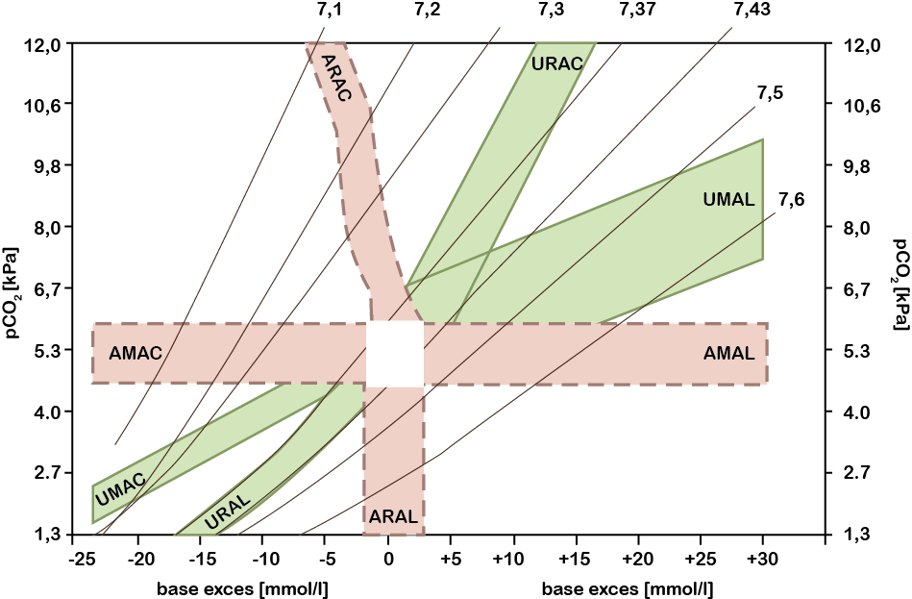
Evaluation of acid-base balance
2
1

Slide 61
Evaluation of cations and anions
Add all the strong cations (Na⁺, K⁺, Ca²⁺, Mg²⁺) and subtract all the anions we measured (Cl⁻, HCO₃⁻, albumin, inorganic phosphate, lactate).
Still left in the anion column:
16.7 mmol/l at first recruitment
24.9 mmol/l in the second recruitment
What kind of anions can these be?
3-Hydroxybutyrate (in urine ketone bodies 1), acetate (from dialysis solution), citrate (anticoagulation)
Na⁺
Cl⁻
HCO₃⁻
albumin⁻
P_{i}⁻
K⁺ , Ca²⁺ , Mg²⁺
UA⁻
„unmeasured“ anions

Slide 62
Further fate of the patient
He was treated with veno-venous haemodiafiltration with anticoagulation with citrate.
Metabolic parameters were gradually adjusted.
2 days after admission, asystole occurred, resuscitation was successful, but renal and pulmonary function gradually deteriorated, rhabdomyolysis occurred – death due to multi-organ failure.

Slide 63
Case report
Carbon monoxide and alcohol poisoning

Slide 64
Current disease
A 36-year-old man was pulled out of his car by a passer-by, who had exhaust fumes hosed into the cabin. He was transported to the emergency room of the University Hospital.
Somnolent, will not comply with a challenge, no need to secure the airway. Breath smells of alcohol. Hydration adequate. Respiration clear and drowsy, heart rate regular, 110/min.
O₂ saturation measured by pulse oxymeter at intake: 98 %

Slide 65
History
According to the medical records, the patient is untreated, but suffers from chronic ethanol abuse and pathological gambling.

Slide 66
Initial laboratory finding
Method and result |  | Unit
pH | 7.23
pCO₂ | 4.5 | kPa
BE | -13.6 | mmol/l
Lactate | 10.7 | mmol/l
Na⁺ | 138 | mmol/l
Glucose | 5.7 | mmol/l
Urea | 33 | mmol/l
Osmolality | 338 | mmol/kg
pO₂ | 228 | kPa
COHb | 0357
O₂Hb | 098
SO₂ | 062

Slide 67
According to the results, it is the following disorder of acid-base balance:
Method and result |  | Unit
pH | 7.23
pCO₂ | 4.5 | kPa
BE | -13.6 | mmol/l
Lactate | 10.7 | mmol/l
Na⁺ | 138 | mmol/l
Glucose | 5.7 | mmol/l
Urea | 3,3 | mmol/l
Osmolality | 338 | mmol/kg
pO₂ | 22.8 | kPa
COHb | 0.357
O₂Hb | 0.98
SO₂ | 0.62
Acute respiratory alkalosis
Acute metabolic acidosis
Partially compensated metabolic acidosis
Fully compensated metabolic acidosis

Slide 68
Comment to question 1
This is a partially compensated metabolic acidosis as seen in compensation diagnostic cross.

Slide 69
Evaluation of AB disorder

Slide 70
Initial laboratory finding
Method and result |  | Unit
pH | 7.23
pCO₂ | 4.5 | kPa
BE | - 13.6 | mmol/l
Lactate | 10.7 | mmol/l
Na⁺ | 138 | mmol/l
Glucose | 5.7 | mmol/l
Urea | 3.3 | mmol/l
Osmolality | 338 | mmol/kg
pO₂ | 22.8 | kPa
COHb | 0.357
O₂Hb | 0.98
SO₂ | 0.62

Slide 71
The patient had lactate metabolic acidosis due to tissue hypoxia. It was hypoxia:
Hypoxic (hypoxaemic)
Anaemic
Circulation
Histotoxic

Slide 72
Comment on question 2
It was anaemic hypoxia, blood was unable to supply oxygen to the tissues, almost 36 % of haemoglobin was occupied by carbon monoxide, haemoglobin saturation dropped to 62 %.
As we will see later, there was simultaneously present acute alcohol intoxication, which probably also contributed to the rise in lactate concentration and MAc.

Slide 73
Initial laboratory finding
Method and result |  | Unit
pH | 7,23
pCO₂ | 4.5 | kPa
BE | - 13.6 | mmol/l
Lactate | 10.7 | mmol/l
Na⁺ | 138 | mmol/l
Glucose | 5.7 | mmol/l
Urea | 3.3 | mmol/l
Osmolality | 338 | mmol/kg
Ethanol | 2.5 | g/l
pO₂ | 22.8 | kPa
COHb | 0.357
O₂Hb | 0.98
SO₂ | 0.62

Slide 74
The patient's breath smelled of alcohol. Is it possible, according to the results, to assume poisoning by alcohol other than ethanol (ethylene glycol, methanol)?
Yes
No

Slide 75
Comment on question 3
Estimation of osmolality from serum Na⁺, glucose and urea concentrations is:
2 Na⁺ + glucose + urea = 2 × 138 + 5.7 + 3.3 = 285
The osmolality gap is therefore: 338 285 = 53, which corresponds to an ethanol concentration of 2.3 g/l (53/23).
Since an ethanol concentration of 2.5 g/l was measured, the presence of other alcohol can be excluded.

Slide 76
Initial laboratory finding
Method and result |  | Unit
pH | 7.23
pCO₂ | 4.5 | kPa
BE | - 13.6 | mmol/l
Lactate | 10.7 | mmol/l
Na⁺ | 138 | mmol/l
Glucose | 5.7 | mmol/l
Urea | 3.3 | mmol/l
Osmolality | 338 | mmol/kg
pO₂ | 22.8 | kPa
COHb | 0.357
O₂Hb | 0.98
SO₂ | 0.62

Slide 77
The fractional saturation (the ratio of O₂ Hb to total Hb) was only 0.62, the partial pressure of oxygen (22 kPa) was higher than the upper reference limit (14.5 kPa), and the oxygen saturation of haemoglobin (functional saturation, i.e. the ratio of O₂ Hb to oxygen-carrying haemoglobin) was 0.98, i.e. normal. The pulse oxymeter showed the same value (0.98).
Which statement is true?
The partial pressure of oxygen cannot be higher than 14.5 kPa, it must be a laboratory error.
The ability of the blood to carry oxygen is expressed by fractional saturation not by functional saturation.
The oxygen-carrying capacity of blood is better indicated by saturation measured by the direct method in the laboratory than by that calculated from pO₂.
Pulse oxymeter shows falsely high saturation values in patients with carbon monoxide poisoning.

Slide 78
Comment on question 3
The high oxygen partial pressure was caused by inhalation of gas with elevated oxygen concentration (FiO₂ = 0.35).
The pulse oxymeter measures oxyhaemoglobin together with COHb, so in CO poisoning the haemoglobin saturation is falsely high.
The saturation calculation from pO₂ gives a big error and does not work at all for CO poisoning. In contrast, the haemoglobin saturation measured in the lab by the direct method gives correct values.
The fractional saturation, i.e. the ratio of oxyhaemoglobin to total haemoglobin, including the so-called dyshaemoglobins that are unable to carry oxygen (carbonylhaemoglobin, methaemoglobin), better indicates the oxygen-carrying capacity of the blood in patients with carbon monoxide poisoning and methaemoglobinaemia.

Slide 79
Oxygen saturation of haemoglobin in a healthy individual
Total haemoglobin (Hb)
Oxyhaemoglobin (O₂Hb)
= haemoglobin
capable of carrying oxygen
Saturation = O₂Hb/Hb (= 98 %)

Slide 80
Saturation of haemoglobin with oxygen person poisoned with carbon monoxide
Haemoglobin
capable of carrying oxygen (64.3 %)
Oxyhaemoglobin (O₂Hb)
Total haemoglobin
Carbonyl haemoglobin (COHb) unable to carry oxygen (35.7 %)

Slide 81
The concept of functional and fractional saturation
Haemoglobin
capable of carrying oxygen (64.3 %)
Oxyhaemoglobin (O₂Hb)
Fractional saturation = O₂Hb/Hb total (= 62 %)
Total haemoglobin
Functional saturation = O₂Hb/Hb capable of carrying oxygen (= 98 %)
Carbonyl haemoglobin (COHb) unable to carry oxygen (35.7 %)

Slide 82
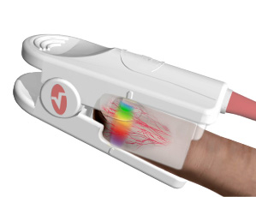
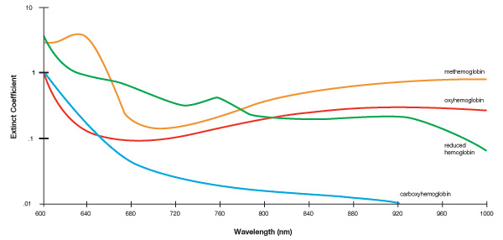
New type of pulse oximeter
Masimo rainbow® Pulse CO-Oximeters™ – measures all fractions in addition to total Hb, i.e. O₂ Hb, COHb and methaemoglobin. Uses 7 wavelengths and special filters for measurement.

Slide 83
Further fate of the patient
The patient was treated with oxygen inhalation at normal pressure (normobaric oxygen therapy).
Control sampling 5 h after admission showed a decrease in COHb to 0.007, SO₂ increased to 0.94.
Baseline hs-cTnT was 10 ng/l and rose to 110 ng/l in 5 h (99th percentile is 14 ng/l); serum myoglobin was 141 µg/l (the upper reference limit for men is 72 µg/l).
The ECG curve was of no ischaemic changes.

Slide 84
Increased cardiac troponin T (and myoglobin) indicates that the patient has had a myocardial infarction.
Yes
No

Slide 85
Comment on question 4
The patient had an acute non-Q myocardial infarction Type 2 in the acute state, i.e. infarction conditioned by ischemic imbalance – according to the 4th universal definition of MI (European Society of Cardiology Guidelines).
The higher troponin level was caused by myocardial ischemia during carbon monoxide intoxication, not by occlusion of a large branch of the coronary artery.

Slide 86
Case report
Primary hyperaldosteronism

Slide 87
Current disease
The 24-year-old woman had been treated for resistant arterial hypertension since February.
At the beginning of September, she stopped the medication and after a few days was brought to the central reception of the University Hospital in Pilsen for vertigo, nausea, vomiting; blood pressure was 230/120 torr.
After a combination of antihypertensives (Tensiomin, Agen, Deprazolin), BP dropped to 170/100 torr; she was discharged home and invited for follow-up the next day.

Slide 88
Current disease – continued
On check-up the next day, BP was again 200/100 torr, so she was admitted to hospital.
Objective examination did not show any pathological findings.
Income laboratory tests are shown in the next table.

Slide 89
Income laboratory tests
Method and result |  | Unit
Na⁺ | 139 | mmol/l
K⁺ | 2.8 | mmol/l
Cl⁻ | 100 | mmol/l
Urea | 2.5 | mmol/l
Creatinine | 66 | μmol/l
pH | 7.51 | mmol/l
pCO₂ | 5,5 | kPa
BE | + 8.6 | mmol/l
Glucose | 6.2 | mmol/l
Leukocytes | 13.4 · 10⁹ | l⁻¹

Slide 90
What can be the cause of resistant hypertension? It is:
Method and result |  | Unit
Na⁺ | 139 | mmol/l
K⁺ | 2.8 | mmol/l
Cl⁻ | 100 | mmol/l
Urea | 2.5 | mmol/l
Creatinine | 66 | μmol/l
pH | 7.51 | mmol/l
pCO₂ | 5.5 | kPa
BE | + 8.6 | mmol/l
Glucose | 6.2 | mmol/l
Leukocytes | 13.4 · 10⁹ | l⁻¹
Essential hypertension
Kidney disease
Secondary hyperaldosteronism
Primary hyperaldosteronism
Hypercorticalism

Slide 91
Comment to question 1
Essential hypertension is not so high and resistant to treatment.
Severe kidney disease can be ruled out because of normal serum urea and creatinine concentrations.
The most likely is hyperaldosteronism (hypokalaemia, metabolic alkalosis).
Secondary hyperaldosteronism is unlikely (negative medical history, young patient), most likely to be primary hyperaldosteronism.
Signs of hypercorticalism (Cushing's syndrome) were not present.

Slide 92
Further investigation procedure
CT scan ruled out renal artery stenosis, laboratory examination showed elevated aldosterone and cortisol concentrations and low renin levels; dexamethasone suppression test was performed.
Method | Result | Reference values | Unit
S-Aldosterone | 1.67 *2.71 | 0.03 – 0.65 0.10 – 0.86 | nmol/l
S-Renin | 0.30 *0.41 | 0.40 – 2.21 0.80 – 8.84 | pmol/l
dU-Cortisol | 596.5 | 39 – 348 | μg/24 h
dU-Cortisol after dexamethasone | 34.4 |  | μg/24 h
*after orthostasis

Slide 93
Which statement is most likely?
The results are consistent with the diagnosis of primary hyperaldosteronism
It is, after all, secondary hyperaldosteronism
The cause of hypercorticalism can be a tumour of the adrenal cortex
The cause of hypercorticalism is probably stress

Slide 94
Comment on question 2
Increased aldosterone concentration and low renin are typical of primary hyperaldosteronism, secondary hyperaldosteronism would have high renin levels.
The cause of hypercorticalism was probably stress (leukocytosis and hyperglycaemia); very good suppression with dexamethasone was also indicative against tumour.

Slide 95
Another fate of the patient
CT scan showed a 22 × 15 mm tumour of the right adrenal gland.
Adrenal hyperplasia with an afunctional adenoma of the right adrenal gland was excluded by aldosterone examination in the right and left adrenal veins.
The patient then underwent surgical removal of a benign adenoma of the right adrenal gland.
She is now off treatment with normal blood pressure, all lab tests have corrected.

Slide 96
Case report
Liver failure

Slide 97
From the medical history
50-year-old woman
Type 2 diabetes mellitus on insulin therapy
Erosive haemorrhagic gastropathy
Chronic alcohol intake (up to 180 g alcohol/day long term)
Ethylic liver cirrhosis with splenomegaly and oesophageal varices diagnosed 6 years ago
Recurrent decompensation of liver cirrhosis in subsequent years
Other dg.: Condition after right-sided adnexectomy for benign cystadenoma (2011)

Slide 98
Current disease
Patient admitted to the emergency department of Pilsen University Hospital for epileptic seizure – assessed as status epilepticus
The clinical picture was dominated by a severe disturbance of consciousness
For the above condition and severe hyponatraemia she was admitted to the ICU of the First Internal Medicine Clinic of the University Hospital in Pilsen
Current treatment: Helicid 2 × 20 mg, Furon 20 mg, Verospiron 50 mg, Insulin Novorapid 3 × 8 U., Sorbifer 2 tbl. per week

Slide 99
We'll start with a blood count
Method and result |  | Unit
Erythrocytes | 2.71 · 10¹² | l⁻¹
Haemoglobin | 64.0 | g/l
Haematocrit | 0.263
Ery volume (MCV) | 97 | fl
Hb ery | 33.5 | pg
Hb conc. | 347 | g/l
Leukocytes | 2.1 · 10⁹ | l⁻¹
Platelets | 44 · 10⁹ | l⁻¹

Slide 100
What is most likely the main cause of anaemia?
Liver cirrhosis with hypersplenism
Vitamin B12 deficiency
Folic acid deficiency
Iron deficiency

Slide 101
Laboratory tests – indicators of iron metabolism
Method and result |  | Normal values | Unit
Iron | 2.2 | 9 – 34 | µmol/l
Transferrin | 2.09 | 2.0 – 3.6 | g/l
Transferrin saturation | 4.0 | 20.0 – 50.0 | %
Ferritin | 41 | 14 – 186 | µg/l
sTfR* | 9.02 | 2.2 – 5.0 | µg/l
*soluble transferrin receptors

Slide 102
Comment
It's obviously iron deficiency anaemia
Chronic iron loss (haemorrhagic gastritis, oesophageal varices) and nutritional disorders with inadequate iron intake may be the cause of anaemia
Iron deficiency is characterized by a low erythrocyte volume with a near-normal erythrocyte count
The biochemical findings should include a high transferrin level in addition to low ferritin and high sTfR

Slide 103
What's wrong here – and why?
low erythrocyte count, but
normal mean erythrocyte volume,
transferrin level at the lower limit of normal
Method and result |  | Unit
Erythrocytes | 2.71 · 10¹² | l⁻¹
Ery volume (MCV) | 97 | fl
Transferrin | 2.09 | g/l
Leukocytes | 2.1 · 10⁹ | l⁻¹
Platelets | 44 · 10⁹ | l⁻¹

Slide 104
Were we thinking right?
Low erythrocyte count, but also leukocytes and platelets are responsible for hypersplenism
Transferrin is produced in the liver, cannot be elevated due to impaired protein synthesis in liver failure
What about the mean erythrocyte volume?
Alcoholics used to have vitamin B12 deficiency and there is macrocytic anaemia – probably it´s a combination of iron and vitamin B12 deficiency anaemia

Slide 105
Blood gas and acid-base examination
Parameter | Result
pH | 7.62
pCO₂ (kPa) | 4.1
HCO₃⁻ (mmol/l) | 32.0
BE (mmol/l) | 10.5
pO₂ (kPa) | 21.8
O₂Hb | 0.98
SO₂ | 1.00

Slide 106
The oxygen partial pressure was 21.8 kPa
Which statement is true?
The partial pressure of oxygen cannot be higher than 14.5 kPa, it must be a laboratory error
This result is only possible when breathing air with elevated oxygen partial pressure
This result is also possible when breathing normal air, namely with hyperventilation

Slide 107
This is the following ABR disorder
Acute metabolic alkalosis
Partially compensated metabolic alkalosis
Partially compensated respiratory alkalosis
Combined disorder
Method and result |  | Unit
pH | 7.62
pCO₂ | 4.1 | kPa
HCO₃⁻ | 32.0 | mmol/l
BE | 10.5 | mmol/l
Notes:
1.
AST
0,77
µkat/l
ALT
0,20
µkat/l
ALP
2,7
µkat/l
AMS
7,85
µkat/l
2.
Glucose
41,0
mmol/l
3.
Urea
6,2
mmol/l
4.
Creatinine
118
µmol/l
5.
At⁺
113
mmol/l
K⁺
4,2
mmol/l
Cl⁻
80
mmol/l
6.
Cholesterol
31,0
mmol/l
7.
Triacylglycerols
69,0
mmol/l

Slide 108
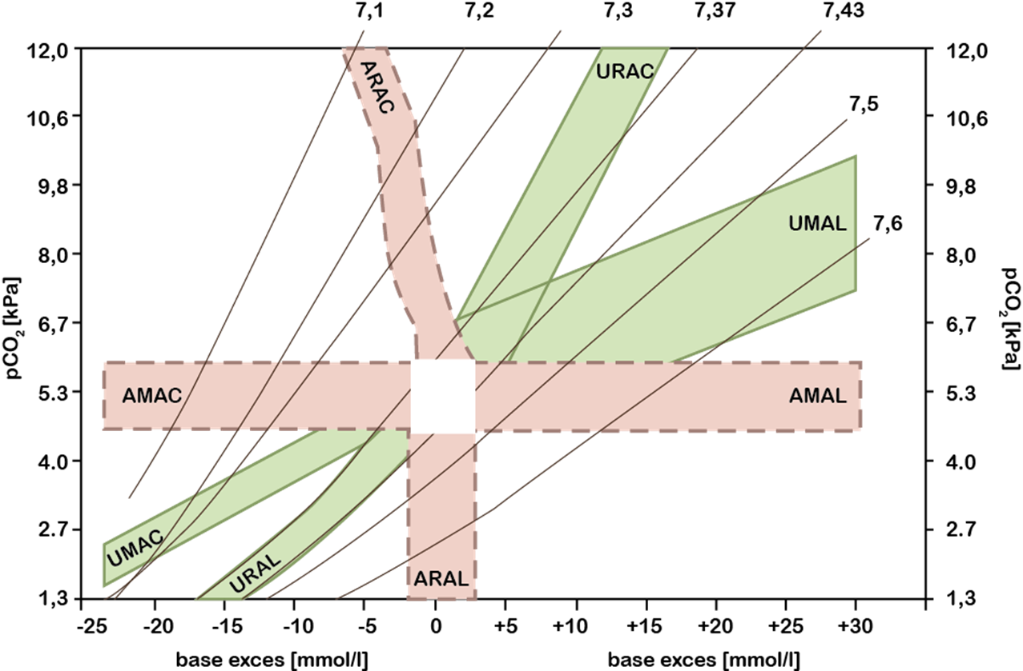
Evaluation of AB status (compensation cross)

Slide 109
Other initial laboratory tests
Method and result |  | Unit
Na⁺ | 109 | mmol/l
K⁺ | 2.5 | mmol/l
Cl⁻ | 60 | mmol/l
Ca²⁺ | 0.83 | mmol/l
Mg | 0.80 | mmol/l
Albumin | 17.2 | g/l
Lactate | 4.5 | mmol/l
Inorg. phosphate | 0.71 | mmol/l
HCO₃⁻ | 32.0 | mmol/l
Urine chemically | glucose 4, ketone bodies 3, blood 2, urobilinogen 1, erythrocytes 172/µl

Slide 110
Estimation of the proportion of metabolic disorders according plasma ion concentration
It is based on the fact, that the anion and cation columns must be equally high
Major cations: Na⁺, K⁺, Ca²⁺, Mg²⁺
Main anions: Cl⁻, albumin, inorganic phosphate and unmeasured anions (UA), i.e. lactate, β-hydroxybutyrate, etc.
A special role is played by the HCO₃⁻ anion; it can be formed in the body from CO₂ or be broken down and replaced by anions of stronger acids
Notes:
The second way of assessing the proportion of metabolic disorders was proposed by Stewart and refined by Fencl.

Slide 111
Estimation of the proportion of metabolic disorders according to Stewart and Fencl
Na⁺
Cl⁻
UA = unmeasured anions (lactate, β-hydroxybutyrate, anions formed by oxidation of alcohols during poisoning, etc.)
P_{i} = inorganic phosphate
HCO₃⁻ varies with the concentration of other ions – dependent variable
HCO₃⁻
albumin⁻
P_{i}⁻
K⁺, Ca²⁺, Mg²⁺
UA⁻
Notes:
Instead of the anion gap, these authors calculate the so-called strong ion difference (SID). It is the difference between the sum of the concentrations of the strong cations (Na⁺ + K⁺ + Ca²⁺ + Mg²⁺ ) and the strong chloride anion.
The graph shows that the SID is the sum of the concentrations of bicarbonate, albumin, inorganic phosphate and the so-called unmeasured anions.

Slide 112
Calculations
Kations = (Na⁺ + K⁺ + Ca²⁺ + Mg ²⁺)
= 109 + 2.5 + 2 × 0.8 + 0.7 = 113.8 mmol/l
Anions consist of:
Cl⁻ = 60 mmol/l
HCO₃⁻ 32 mmol/l
Albumin = albumin (pH – 5.17) · 0.125 = 5.3 mmol/l
Inorganic phosphate = phosphate (pH × 0.309 – 0.469) = 1.3 mmol/l
UA = 113.8 – (60 + 32 + 5.3 + 1.3) = 15.2 mmol/l
Notes:
The second way of assessing the proportion of metabolic disorders was proposed by Stewart and refined by Fencl.

Slide 113
Calculations
UA 15.2 mmol/l consist of:
Lactate 4.5 mmol/l
The remainder (10.7 mmol/l) consists mainly of ketone bodies, especially β-hydroxybutyrate
Notes:
The second way of assessing the proportion of metabolic disorders was proposed by Stewart and refined by Fencl.

Slide 114
The patient had a combined AB disorder
Metabolic alkalosis
secondary hyperaldosteronism (diuretics, low oncotic pressure and therefore bloodstream filling)
hypoalbuminaemia (HCO₃⁻ replaces albumin in the anion column)
Metabolic acidosis
lactate (status epilepticus, hepatopathy)
ketoacidosis (decompensated diabetes mellitus)
Respiratory alkalosis
irritation of the respiratory centre by substances that accumulate in the blood due to liver failure
Notes:
The second way of assessing the proportion of metabolic disorders was proposed by Stewart and refined by Fencl.

Slide 115
"Liver tests"
Method and result |  | Normal values | Unit
Total bilirubin | 59 | 9 – 34 | µmol/l
AST | 2.10 | < 0,60 | µkat/l
ALT | 1.01 | < 0.70 | µkat/l
ALP | 1.52 | 0.70 – 2.20 | µkat/l
GGT | 10.88 | < 1.30 | µkat/l

Slide 116
Increased GGT activity and normal ALP indicate toxic liver injury
Method and result |  | Normal values | Unit
ALP | 1.52 | 0.70 – 2.20 | µkat/l
GGT | 10.88 | < 1.30 | µkat/l
What other tests could confirm alcoholic liver damage?
AST/ALT ratio
Carbohydrate-deficient transferrin (CDT)
Ethyl glucuronide in urine
Cystatin C in serum

Slide 117
Comment
Alcoholics have an increased proportion of carbohydrate deficient transferrin (CDT) as an expression of impaired post-translational modification of the transferrin molecule in hepatocytes
Urinary ethyl glucuronide reflects higher alcohol intake maximum in the last 4 days
Cystatin C shows glomerular filtration rate
The importance of the AST/ALT ratio will be the subject of the next question

Slide 118
AST/ALT ratio > 1 (1.91 in our patient) is indicative of
Method and result |  | Unit | Ref. values
AST | 2.10 | μkat/l | < 0.60
ALT | 1.10 | μkat/l | < 0.70
CK | 8.58; 16.65* | μkat/l | < 2.40
Myoglobin | 382 | μg/l | 25 – 58
* next day
Contribution of obstruction to icterus
Mild liver cell damage
Severe liver cell damage
Skeletal muscle damage

Slide 119
Comment
An AST/ALT ratio > 1 indicates severe liver cell damage (necrosis). While ALT is a pure cytoplasmic enzyme, approximately 2/3 of AST are in the mitochondria – and it is this proportion that is washed into the blood from the dead mitochondria during hepatocyte necrosis
The AST/ALT ratio is also elevated in skeletal muscle damage, as indicated by increased CK activity and myoglobin concentration. The cause is most likely due to spasms prior to admission

Slide 120
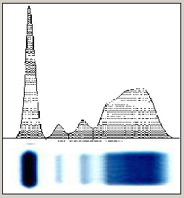
Eectrophoresis of serum proteins
Fractions | Result
Albumin | 0.369 ↓
 | 17.2 g/l ↓
Globulin α₁ | 0.055
α₂ | 0.114
β | 0.152
γ | 0.310 ↑

Slide 121
Comment
Significant increase in the proportion of γ-globulins, finding of β-γ bridge and marked hypoalbuminaemia belong among to the picture of chronic hepatopathy
The normal proportion of α₁, α₂ and β fractions may be due to inflammatory complications
Protein malnutrition certainly contributes to the finding
β-γ bridge

Slide 122
Conclusion
The next course was complicated by infectious complications and fluidothorax
She was transferred to a standard bed and discharged to home care after 1.5 months of hospitalization

Slide 123
Case report
Tertiary hyperparathyroidism

Slide 124
Medical history and current disease
50-year-old patient with chronic glomerulopathy and nephrotic-type proteinuria
From the medical history
Due to progressive decline in renal function, at the age of 31 (II/1999) he was placed on a chronic haemodialysis programme.
After 8 months of chronic dialysis treatment, he received a cadaveric kidney transplant (X/1999), which maintained good function for 11 years. (until X/2011).

Slide 125
Medical history and current disease
Immediately before the current illness he had acute pancreatitis and cholangitis with subsequent laparoscopic gallbladder removal and bile duct revision.
He was treated for presumed secondary hyperparathyroidism throughout dialysis treatment and during functional kidney transplant.

Slide 126
Hyperparathyroidism
Add ↑ (increased) or ↓ (decreased)
Hyperparathyroidism | S-Ca²⁺ | S-P_{i} | U-Ca | U-P_{i}
Primary
Secondary
↑
↓
↑
↑
↓
↑

Slide 127
Hyperparathyroidism
Add ↑ (increased) or ↓ (decreased)
Hyperparathyroidism | S-Ca²⁺ | S-P_{i} | U-Ca | U-P_{i}
Primary
Secondary |  |  | according to kidney function
↑
↓
↑
↑
↓
↑

Slide 128
Treatment of secondary hyperparathyroidism
Calcium p.o.
1,25-dihydroxyvitamin D or 1α-hydroxyvitamin D
Paricalcitol – synthetic analogue of vitamin D, inhibits PTH production and does not increase phosphate absorption
Phosphate binders
Calcimimetics

Slide 129
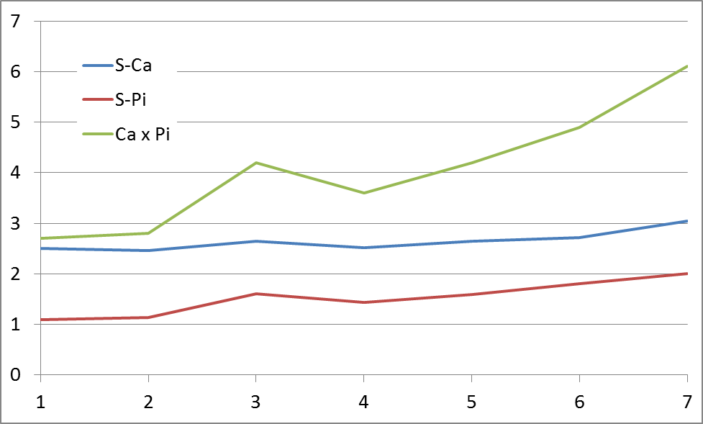
Further course of the disease – calcium and phosphate metabolism
mmol/l
II/14 VI/15 XII/15 VI/16 XI/16 III/17 VI/17

Slide 130
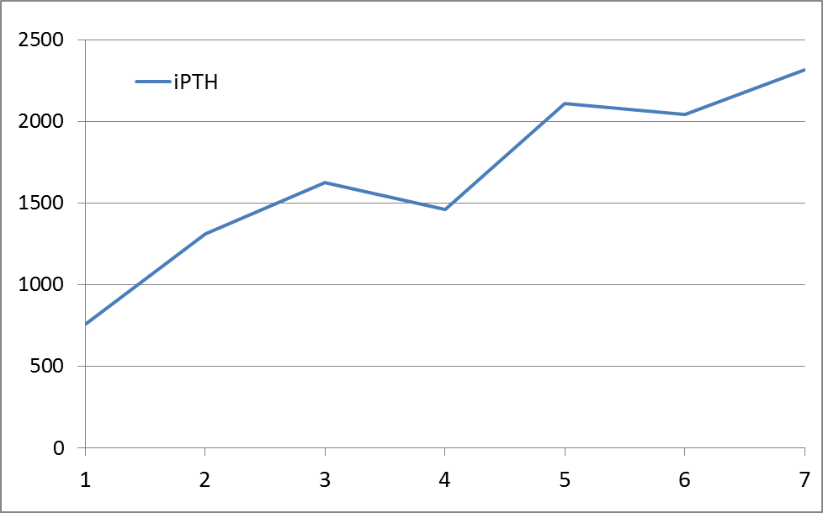
Further course of the disease – parathyroid hormone
ng/l
II/14 VI/15 XII/15 VI/16 XI/16 III/17 VI/17

Slide 131
Establishing the diagnosis
Despite the treatment of secondary hyperparathyroidism, the concentration of intact parathyroid hormone (iPTH) and eventually serum calcium increased.
The high calcium-phosphate product indicated the risk of metastatic calcification.
The patient underwent CT scan of the parathyroid glands with the finding of adenoma of the right lower parathyroid gland (29 × 30 × 43 mm). Subsequently, extirpation of the adenoma was performed.

Slide 132
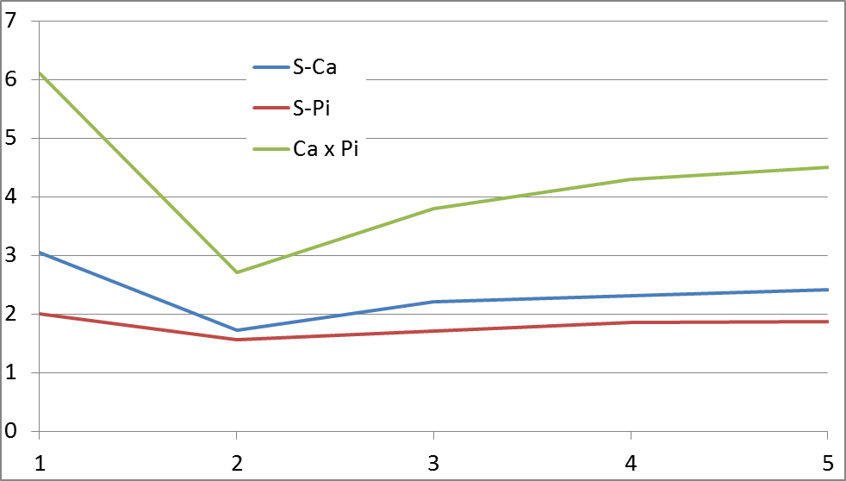
Postoperative course – calcium and phosphate metabolism
mmol/l
IVI17 before VI/17 after VII/17 IX/17 I/18

Slide 133
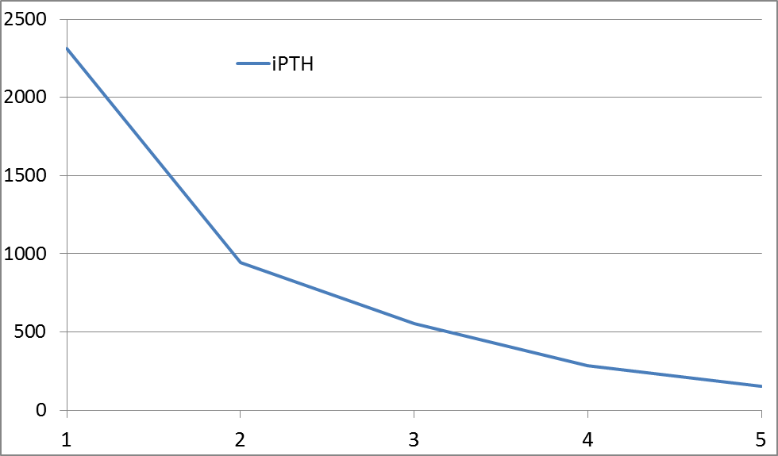
Postoperative course – parathyroid hormone
ng/l
IVI17 before VI/17 after VII/17 IX/17 I/18

Slide 134
Conclusion
The patient developed a parathyroid adenoma as a result of long-standing secondary hyperparathyroidism, which escaped follow-up – it was tertiary hyperparathyroidism.
It is characterized by increasing concentrations of PTH and Ca; the effect of PTH on the renal tubules could not manifest itself due to chronic renal failure, therefore the concentration of inorganic phosphate in the blood serum did not decrease.
The reason for the sudden onset of hypocalcaemia after adenoma extirpation is the intense Ca uptake from the ECF due to the skeletal demineralization that occurred during the previous years ("hungry bone syndrome"). The transitional period should be bridged by i.v. calcium administration.

Slide 135
Case report
Ethylene glycol poisoning

Slide 136
Current disease
The 36-year-old patient was last seen by her family between 2 and 3 p.m. She was planning Christmas with her mother at noon and was out of trouble
8 p. m. she was found unconscious, grunting, vomiting
She was taken to University Hospital to the acute ward

Slide 137
History
Mental anorexia, bulimia from 18 years of age
Since 2001, she has been drinking alcohol more frequently, has been treated for alcoholism several times, has violated her regime
Last admitted to drinking 0.5 litres of vodka a day 3 months ago
2 days before admission she was discharged from the detoxification unit of the Psychiatric Clinic of the University Hospital in Pilsen, where she was treated for alcoholism
Previously repeatedly hospitalized for septic condition due to pneumonia, metabolic disorder due to alcoholic excesses and bulimia

Slide 138
Initial laboratory finding
Method and result |  | Unit
pH | 6,93
pCO₂ | 4,2 | kPa
BE | - 25.9 | mmol/l
pO₂ | 10.1 | kPa
SO₂ | 0.95
Lactate | 5.7 | mmol/l
Urea | 5.1 | mmol/l
Creatinine | 174 | μmol/l
Glucose | 14.4 | mmol/l
The osmolal gap | 35 | mmol/kg
Ethanol | neg.
Drug screening | neg.
Ketone bodies in urine | 1

Slide 139
What is the most likely underlying cause of severe metabolic acidosis?
Severe tissue hypoxia and lactate overproduction
Ketoacidosis (starvation?)
Kidney failure
Methanol poisoning
Ethylene glycol poisoning
Method and result |  | Unit
pH | 6.93
pCO₂ | 4.2 | kPa
BE | - 25.9 | mmol/l
pO₂ | 10.1 | kPa
SO₂ | 0.95
Lactate | 5.7 | mmol/l
Urea | 5.1 | mmol/l
Creatinine | 174 | μmol/l
Glucose | 14.4 | mmol/l
The osmolal gap | 35 | mmol/kg
Ethanol | neg.
Drug screening | neg.
Ketone bodies in urine | 1

Slide 140
Comment to question 1
The lactate concentration of 5.7 mmol/l does not correspond to the value of BE - 25,9 mmol/l.
The relatively low concentration of ketone bodies (in urine 1) could not be the cause of such severe MAc.
The renal failure was not severe (creatininaemia 174 μmol/l), so it could not have caused such severe MAc.
Methanol poisoning is the most likely case of severe MAc (methanol is oxidized to a relatively strong formic acid, lactate also rises; the patient was an alcoholic, repeatedly unsuccessfully treated, osmolality gap was positive).
Ethylene glycol poisoning can also cause severe MAc with a positive osmolality gap.

Slide 141
Finding in urine
Analyt | Result
pH | 5.5
Protein | 2
Glucose | 1
Kettlebells | 1
Blood | 3
Erythrocytes | 249/μl
Ca oxalate crystals | present in high amount

Slide 142
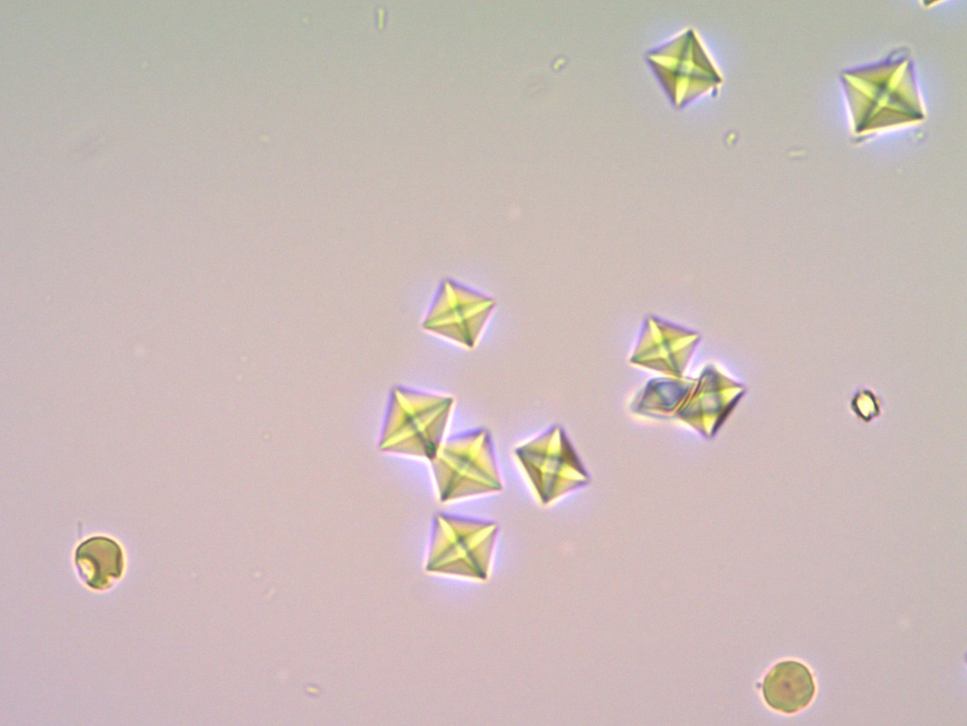
Urinary sediment
Ethylene glycol (the active ingredient in Fridex) is metabolized to oxalic acid, which is excreted in the urine as a calcium salt.

Slide 143
Another fate of the patient
She was treated with continuous haemodialysis and ethanol i.v.
In the next sample, the alcohol concentration was 0.6 g/l and the serum osmolality increased from 345 to 360 mmol/kg.

Slide 144
Which statement is true?
The increase in osmolality is proportional to the concentration of ethanol administered.
A blood ethanol concentration of 0.6 g/l is insufficient, it should be above 1 g/l.
The goal of ethanol administration is to accelerate the breakdown of ethylene glycol.
The goal of ethanol administration is to slow the breakdown of ethylene glycol.

Slide 145
Comment on question 3
The increase in osmolality is proportional to the concentration of ethanol administered (1 g ethanol/l increases osmolality by about 23 mmol/kg).
In the treatment of ethylene glycol poisoning, an ethanol concentration of between 1.0 – 1.5 g/l should be maintained to sufficiently inhibit ethylene glycol degradation.
The aim of ethanol administration is to slow the oxidation of ethylene glycol by alcohol dehydrogenase and the formation of toxic products; the affinity of ethanol for alcohol dehydrogenase is about 100 times higher than that of ethylene glycol.

Slide 146
Case report
Decompensated diabetic

Slide 147
Decompensated diabetic
A 77-year-old diabetic patient was admitted to the intensive care unit of the 2nd internal medicine clinic of the University Hospital in Pilsen; he was treated with insulin using a pump (the pump had not worked for the last 3 days).
The day before admission, he vomited repeatedly, on the day of admission he shows worse breathing.
Somnolent, trying to cooperate.
Kussmaul's breathing, cyanotic acre, signs of centralization of blood circulation, oliguria, BP 80/55 mmHg.

Slide 148
Medical history and diagnoses
Insulin-dependent diabetes mellitus with multiple complications since 1977
Diabetic proliferative retinopathy
Diabetic peripheral polyneuropathy
Atrial fibrillation, warfarinized
Arterial hypertension
Hypercholesterolaemia
Microscopic haematuria, dispensed by urologist

Slide 149
Initial laboratory examination
Method and result |  | Unit
Glucose | 68.5 | mmol/l
Na⁺ | 125 | mmol/l
K⁺ | 7.2 | mmol/l
Cl⁻ | 90 | mmol/l
Urea | 17.3 | mmol/l
Creatinine | 257 | µmol/l
pH | 6.85
pCO₂ | 2.9 | kPa
HCO₃⁻ | 3.9 | mmol/l
BE | - 29.9 | mmol/l
Lactate | 5.1 | mmol/l
Urine chemically | glucose 4, ketone bodies 3, blood 2

Slide 150
Initial laboratory examination acid-base balance
Method and result |  | Unit
Glucose | 68.5 | mmol/l
Na⁺ | 125 | mmol/l
K⁺ | 7.2 | mmol/l
Cl⁻ | 90 | mmol/l
Urea | 17.3 | mmol/l
Creatinine | 257 | µmol/l
pH | 6.85
pCO₂ | 2.9 | kPa
HCO₃⁻ | 3.9 | mmol/l
BE | - 29.9 | mmol/l
Lactate | 5.1 | mmol/l
Urine chemically | glucose 4, ketone bodies 3, blood 2

Slide 151
This is the following ABR disorder
Acute metabolic acidosis
Partially compensated metabolic acidosis
Fully compensated metabolic acidosis
Compensated respiratory alkalosis
Method and result |  | Unit
pH | 6.85
pCO₂ | 2.9 | kPa
HCO₃⁻ | 3.9 | mmol/l
BE | - 29.9 | mmol/l
Notes:
1.
AST
0,77
µkat/l
ALT
0,20
µkat/l
ALP
2,7
µkat/l
AMS
7,85
µkat/l
2.
Glucose
41,0
mmol/l
3.
Urea
6,2
mmol/l
4.
Creatinine
118
µmol/l
5.
At⁺
113
mmol/l
K⁺
4,2
mmol/l
Cl⁻
80
mmol/l
6.
Cholesterol
31,0
mmol/l
7.
Triacylglycerols
69,0
mmol/l

Slide 152
Evaluation of acid-base balance

Slide 153
Comment to question 1
It is a metabolic acidosis, induced by the accumulation of ketone bodies in the decompensation of diabetes and partly lactate in tissue hypoxia (centralisation of blood circulation).
The disorder is partially compensated (elderly patient with ventilation disorder – lung emphysema).

Slide 154
Initial laboratory examination sodium
Method and result |  | Unit
Glucose | 68.5 | mmol/l
Na⁺ | 125 | mmol/l
K⁺ | 7.2 | mmol/l
Cl⁻ | 90 | mmol/l
Urea | 17.3 | mmol/l
Creatinine | 257 | µmol/l
pH | 6.85
pCO₂ | 2,9 | kPa
HCO₃⁻ | 3.9 | mmol/l
BE | - 29.9 | mmol/l
Lactate | 5.1 | mmol/l
Urine chemically | glucose 4, ketone bodies 3, blood 2

Slide 155
What causes hyponatraemia?
Loss of sodium during vomiting
Dehydration when vomiting
Fluid transfer from intracellular to extracellular space in hyperglycaemia (and thus significantly increased plasma osmolality)

Slide 156
Comment on question 2
Severe hyperglycaemia is often accompanied by hyponatraemia for osmotic reasons: the reason is the transfer of water from the intra- to the hyperosmolar extracellular space.
↑ Glycaemia of 10 mmol/l will induce ↓ Na⁺ of about 3 mmol/l.
In our case, it's a rise in glycaemia by 68.5 – 5 mmol/l = 63.5 mmol/l; this causes a decrease in Na⁺ of 63.5/10 ) × 3 = 19 mmol/l.
When glycaemia is normalised, a rise in Na⁺ to 125 + 19 = 144 mmol/l can be expected.

Slide 157
Changes in Na⁺ concentration after correction for glycaemia
(mmol/l)
Na⁺
Na⁺ corr.
(Hours after admission)

Slide 158
Initial laboratory tests chlorides
Method and result |  | Unit
Glucose | 68.5 | mmol/l
Na⁺ | 125 | mmol/l
K⁺ | 7.2 | mmol/l
Cl⁻ | 90 | mmol/l
Urea | 17.3 | mmol/l
Creatinine | 257 | µmol/l
pH | 6.85
pCO₂ | 2.9 | kPa
HCO₃⁻ | 3.9 | mmol/l
BE | - 29.9 | mmol/l
Lactate | 5.1 | mmol/l
Urine chemically | glucose 4, ketone bodies 3, blood 2

Slide 159
Patient has vomited repeatedly, has decreased serum chloride concentration
Is it really hypochloridaemia (with respect to Na⁺ concentration?)
Yes
No

Slide 160
Comment on question 3
The chlorides concentration should always be correlated with the sodium concentration.
We calculate the corrected chlorides (i.e., the chloride concentration the patient would have with normal sodium level):
Cl⁻_{cor} = Cl⁻_{measured} × Na⁺_{normal} /Na⁺_{measured}
A value of 101 mmol/l indicates normochloridaemia.

Slide 161
Initial laboratory examination potassium
Method and result |  | Unit
Glucose | 68.5 | mmol/l
Na⁺ | 125 | mmol/l
K⁺ | 7.2 | mmol/l
Cl⁻ | 90 | mmol/l
Urea | 17.3 | mmol/l
Creatinine | 257 | µmol/l
pH | 6.85
pCO₂ | 2.9 | kPa
HCO₃⁻ | 3.9 | mmol/l
BE | - 29.9 | mmol/l
Lactate | 5.1 | mmol/l
Urine chemically | glucose 4, ketone bodies 3, blood 2

Slide 162
The patient had hyperkalaemia 7.2 mmol/l
Kalaemia > 6.5 mmol/l is an indication to start haemodialysis. Is this also true in this case?
Yes
No

Slide 163
Comment on question 4
In acidaemia, H⁺ ions move into the cells (mainly erythrocytes) and K⁺ ions leak from them into the plasma.
When the pH rises, the process is reversed and plasma potassium decreases.
A change in pH of 0.1 corresponds to a change in K⁺ concentration by approximately 0.6 mmol/l.
In our case, when normalization occurs, the pH will increase from 6.85 to 7.40; i.e. increase by 0.55.
This corresponds to a decrease in K⁺ of 5.5 × 0.6 = 3.3 mmol/l, final K⁺ level will be 7.2 – 3.3 = 3.9 mmol/l.

Slide 164
Changes in concentration of K⁺ after correction for pH
(mmol/l)
(Hours after admission)

Slide 165
How best to assess nitrogen catabolite levels?
Method | On receipt | Before release | Unit
Urea | 17.3 | 3.9 | mmol/l
Creatinine | 257 | 104 | μmol/l
The cause of development of acute renal failure was:
Dehydration (osmotic diuresis, vomiting) with centralisation of blood circulation and renal hypoperfusion
Presumed diabetic nephropathy (DM 39 years, ACR 22.5 g/mol creatinine)

Slide 166
Comment on question 5
Acute renal failure was caused by hypoperfusion of the renal cortex during dehydration (osmotic diuresis, vomiting).
It is highly likely that the present diabetic nephropathy (albuminuria, retinopathy, haematuria) contributed to the rapid deterioration of renal function.

Slide 167
Cardiac markers
Levels of CK, myoglobin and cardiac-specific hs-cTnT showed pathological results.
The patient had no chest pain, no ischaemic lesions on the admission ECG.
Coronarography did not show significant narrowing of any of the coronary artery branches.
Echocardiographic examination showed normal cardiac kinetics.

Slide 168
Has the patient had a myocardial infarction?
 | Reference values | Unit | Time after admission
 |  |  | 0 h | 4 h | 9 h | 21 h | 45 h
CK | < 3.2 | μkat/l | 6.7 | 11.3 | 17.6 | 23.6 | 13.8
Myoglobin | < 72 | μg/l | 1380 | 2720 | 2310 | 1700 | 630
hs-cTnT | < 14 | ng/l | 122 | 373 | 1299 | 2798 | 1421

Slide 169
Has the patient had a myocardial infarction?
 | Reference values | Unit | Time after admission
 |  |  | 0 h | 4 h | 9 h | 21 h | 45 h
CK | < 3.2 | μkat/l | 6.7 | 11.3 | 17.6 | 23.6 | 13,8
Myoglobin | < 72 | μg/l | 1380 | 2720 | 2310 | 1700 | 630
hs-cTnT | < 14 | ng/l | 122 | 373 | 1299 | 2798 | 1421
Yes
No

Slide 170
Comment on question 6
Patient had an acute non-Q myocardial infarction Type 2 in the acute state: infarction caused by ischaemic imbalance – according to the 4th universal definition of MI (European Society of Cardiology Guidelines).
The cause was myocardial hypoperfusion during dehydration and hypotension, not occlusion of a large branch of the coronary artery.

Slide 171
Further fate of the patient
Patient introduced to fractionated insulin administration by pen.
For paroxysmal atrial fibrillation with a tendency to rapid ventricular response, beta-blocker therapy was enhanced.
The patient was discharged home after 16 days of hospitalization and transferred to outpatient diabetes care.

Slide 172
Final acute diagnoses
Diabetic ketoacidosis as a consequence of insulin pump shutdown
Renal insufficiency from prerenal cause in diabetic ketoacidosis
Disorders of mineral metabolism – hyponatraemia, hypochloraemia, hyperkalaemia
Acute non-Q type 2 myocardial infarction in the acute state
Paroxysmal atrial fibrillation, warfarinization

Slide 173
Case report
Methaemoglobinaemia

Slide 174
History
2.5-year-old boy
Spontaneous delivery at 32 weeks by cephalic delivery, birth weight 2000 g, length 46 cm, Apgar score 9-10-10 points
Gradual development of dyspnoea, exogenous surfactant given, ventilatory support 4 days, oxygen therapy 3 days
Further development normal, eliminated at 6 months off the register

Slide 175
Current disease
Boy brought to the pediatric ICU severely cyanotic, with fluctuating state of consciousness, repeatedly vomiting
Normal body temperature, mild tachycardia (HR 160/min), normotensive (BP 110/60 torr), eupnoic (BR 22/min)
Other physical findings normal
Blood taken for blood gas and acid-base tests

Slide 176
Examination of blood gases
 | 11.10. 21.20 h
pH | 7.05
pCO₂ (kPa) | 9.9
HCO₃⁻ (mmol/l) | 19.9
BE (mmol/l) | - 9.2
Lactate (mmol/l) | 6.51
What kind of acid-base balance disorder was present?

Slide 177
Evaluation of acid-base balance

Slide 178
Examination of blood gases
 | 11.10. 21.20 h
pH | 7.05
pCO₂ (kPa) | 9.9
HCO₃⁻ (mmol/l) | 19.9
BE (mmol/l) | - 9.2
O₂Hb | 1.00
SO₂ | 0.42
Lactate (mmol/l) | 6.51
Functional saturation = O₂Hb/Hb capable of carrying oxygen
Fractional saturation = O₂Hb/Hb total

Slide 179
Next procedure
The difference between the functional and fractional saturation must lead to the suspicion of the presence of dyshaemoglobin (COHb, metHb)
The mother ruled out carbon monoxide intoxication, the child was not given any medication
For dinner, he had a dish of raw pumpkin (up to 500 ml) and was put to sleep; after about 15 minutes of sleep, his mother noticed a pronounced cyanosis
Laboratory evidence of methaemoglobin > 30 % (must have been at least 50 % according to clinical signs!)
Oxygen therapy started, methylene blue i.v., aspiration of stomach contents performed at the time of admission

Slide 180
Examination of blood gases after treatment
 | 11.10. 21.20 h | 12. 10. 6.20 h
pH | 7.05 | 7.39
pCO₂ (kPa) | 9.9 | 4.7
HCO₃⁻ (mmol/l) | 19.9 | 21.3
BE (mmol/l) | - 9.2 | - 3.4
O₂Hb | 1.00 | 0.99
SO₂ | 0.42 | 0.98
Lactate (mmol/l) | 6.51 | 1.72

Slide 181
Conclusion
The cause of methaemoglobinaemia was high nitrate in pumpkin bought at the market (several times the legal limit), improper processing and large quantities of ingested pumpkin
Child discharged home after 9-day hospitalization in good condition with the following diagnoses:
D748 Methaemoglobinaemia – acute > 30%
T659 Toxic effect of other and unspecified substances – toxic effect of unspecified substance
J690 Pneumonia on the right caused by food and vomit
J969 Respiratory failure, NS
X4900 Accidental poisoning with other and NS chemicals and harmful substances and exposure – home
R230 Cyanose
R400 Impairment of consciousness
Q257 Mild haemodynamically insignificant pulmonary stenosis

Slide 182
Case report
Preeclampsia and HELLP syndrome

Slide 183
Description of the case
A 33-year-old woman, a primigravida, came in for a regular check-up
Swelling of the fingers, face and lower limbs, in the evening allegedly to the middle of the calves
Hypertension detected for the first time (BP 160/110 mmHg)

Slide 184
What other tests would you prescribe?
Serum protein concentration
Serum albumin concentration
Losses of albumin (protein) in the urine
Serum sFLT-1/PlGF ratio
sFLT-1 = soluble fms-like tyrosine kinase-1 PlGF = placental growth factor

Slide 185
Comment
Two typical signs of preeclampsia were present: oedema and hypertension
The third sign is increasing proteinuria or albuminuria
Changes in protein or albumin concentration in serum are not an early sign
The diagnosis of preeclampsia can be confirmed by a high sFLT-1/PlGF serum ratio
sFLT-1 = soluble fms-like tyrosine kinase-1
PlGF = placental growth factor

Slide 186
How did it work out for our patient?
Parameter | Sick | Reference values
dU-protein (g) | 5.02 | < 0.3 (0.5) g
PCR (g/mol) | 259.4 | < 80
sFLT-1/PlGF | 163 | < 30
PCR = protein creatinine ratio
Due to obvious signs of pre-eclampsia and further rising blood pressure (208/104 mmHg) the patient was admitted to the Gynaecology and Obstetrics Clinic and the pregnancy was terminated by section

Slide 187
Laboratory tests at admission and on the day of delivery
Analyt | The day after admission
 | 0 | 1 (childbirth)
B-Thrombocytes (· 10⁹/l) | 210 | 213
S-Bilirubin (µmol/l) | 3 | 3
S-AST (µkat/l) | 0.40 | 0.82
S-ALT (µkat/l) | 0.43 | 0.83
S-LD (µkat/l) | - | 3.65
S-Creatinine (µmol/l) | 61 | 70
S-Albumin (g/l) | - | 30.4
U-Protein (g/l) | 5.02 | -
U-PCR (g/mol) | 259.4 | -
Slight increase in aminotransferases activity after cesarean delivery attributed to with the procedure

Slide 188
Results the next day
Analyt | The day after admission
 | 0 | 1 (childbirth) | 2
B-Thrombocytes (· 10⁹/l) | 210 | 213 | 22
S-Bilirubin (µmol/l) | 3 | 3 | 30
S-AST (µkat/l) | 0.40 | 0.82 | 18.4
S-ALT (µkat/l) | 0.43 | 0.83 | 11.2
S-Urea (mmol/l) | 6.2 | 7.9 | 9.9
S-Creatinine (µmol/l) | 61 | 70 | 81
S-Albumin (g/l) | - | 30.4 | 24.1
U-Protein (g/l) | 5.02 | - | -
U-PCR (g/mol) | 259.4 | - | -
A large increase in AST and ALT activities, a rise in bilirubin and especially extreme thrombocytopenia raised suspicion of HELLP syndrome

Slide 189
There, in addition to thrombocytopenia and high liver enzyme activity, include haemolysis
Which examination would you choose?
Erythrocyte count
Lactate dehydrogenase (LD) activity
Serum haptoglobin concentration
Free haemoglobin in serum

Slide 190
Initial laboratory examination
Analyt | The day after admission
 | 0 | 1 (childbirth) | 2
B-Thrombocytes (· 10⁹/l) | 210 | 213 | 22
S-Bilirubin (µmol/l) | 3 | 3 | 30
S-AST (µkat/l) | 0.40 | 0.82 | 18.4
S-ALT (µkat/l) | 0.43 | 0.83 | 11.2
S-LD (µkat/l) |  |  | > 30.0
S-Haptoglobin (g/l) |  |  | < 0.03
S-Urea (mmol/l) | 6.2 | 7.9 | 9.9
S-Creatinine (µmol/l) | 61 | 70 | 81
S-Albumin (g/l) | - | 30.4 | 24.1
U-Protein (g/l) | 5.02 | - | -
U-PCR (g/mol) | 259.4 | - | -
Haemolysis confirmed

Slide 191
Comment
The most specific indicator of intravascular haemolysis is a sharp drop in haptoglobin concentration
Lactate dehydrogenase released from erythrocytes and free haemoglobin are also indicative of haemolysis, but they also rise in artificial haemolysis during blood collection and processing
How did the laboratory results evolve further?

Slide 192
All results were improving
Analyt | The day after admission
 | 0 | 1 (childbirth) | 2 | 3 | 4 | 6
B-Thrombocytes (· 10⁹/l) | 210 | 213 | 22 | 76 | 117 | 226
S-Bilirubin (µmol/l) | 3 | 3 | 30 | 32 | 8 | 5
S-AST (µkat/l) | 0.40 | 0.82 | 18.4 | 7.55 | 3.49 | 0.89
S-ALT (µkat/l) | 0.43 | 0.83 | 11.2 | 9.89 | 8.28 | 4.64
S-LD (µkat/l) | - | 3.65 | > 30.0 | 24.0 | 11.5 | 7.06
S-Haptoglobin (g/l) | - | 0.25 | < 0.03 | 0.33 | - | 0.91
S-Urea (mmol/l) | 6.2 | 7.9 | 9.9 | 9.1 | 6.2 | 6.6
S-Creatinine (µmol/l) | 61 | 70 | 81 | 71 | 55 | 49
S-Albumin (g/l) | - | 30.4 | 24.1 | 21.7 | 27.7 | 29.0
S-Magnesium (mmol/l) | - | - | 1.47 | 1.24 | 1.79 | -
U-Protein (g/l) | 5.02 | - | - | - | - | 2.09
U-PCR (g/mol) | 259.4 | - | - | - | - | 163.0

Slide 193
Comment and question
Signs of liver involvement, haemolysis were receding and platelet counts were rising
Transient increase in urea and creatinine concentration showed renal impairment
Why the high magnesium?
It's an intracellular ion, released during haemolysis
Due to impaired kidney function, it accumulated in the blood
It was given therapeutically as a prevention of convulsions

Slide 194
Comment
The ratio of magnesium concentration in erythrocytes and plasma is only 2.5 (for potassium it is 22)
The renal impairment was only mild, not resulting in magnesium retention
Magnesium is given intravenously to prevent cramps while monitoring levels, it should be 1.65 – 3.30 mmol/l

Slide 195
Final evaluation of the case
The patient had typical clinical and laboratory signs of pre-eclampsia
After termination of pregnancy, HELLP syndrome developed, whose laboratory indicators (thrombocytopenia, increased aminotransferase activity, signs of haemolysis) gradually subsided
Mild elevation of urea and creatinine showed transient impairment of renal function

Slide 196
Case report
Pseudohyperkalaemia in thrombocytosis

Slide 197
Medical history and current disease
56-year-old patient, multiple hospitalizations at the dermatovenerology clinic for lymphoedema of the left lower limb after repeated erysipelas
Other diagnoses:
Condition after left inguinal hernia surgery 15 years ago
Hepatic cirrhosis v.s. ethylic
Condition after central stroke (01 and 04/2011) with residual dysarthria
Hypertension
Post-traumatic ulceration on the dorsum of the right foot, infected (Staphylococcus aureus)

Slide 198
Medical history and current disease
Laboratory findings revealed hyperkalaemia 6.1 mmol/l
The internal consultant recommended:
Resonium (= cation-exchanger) 3 × 1 spoon p.o.
in case of other potassium rise, 250 ml of 10% glucose + 14 j. Actrapid insulin

Slide 199
Laboratory findings – biochemistry
Method and result |  | Unit
Na⁺ | 135 | mmol/l
K⁺ | 6.1 | mmol/l
Cl⁻ | 103 | mmol/l
Urea | 6.0 | mmol/l
Creatinine | 80 | µmol/l
Glucose | 5.1 | mmol/l
CRP | 65 | mg/l
Bilirubin, AST, ALT | within the reference range

Slide 200
Possible causes of hyperkalaemia
Kidney failure with oligo- or anuria; hyperkalaemia with normal renal function (creatinine 80 µmol/l) is very rare
The cause may be hypoaldosteronism (primary or secondary to impaired renin secretion)
Another cause could be the administration of drugs that block the renin-angiotensin-aldosterone system (they lead to lower aldosterone production and therefore increased potassium resorption
These conditions were not an option for the patient
The result of blood cell count was interesting

Slide 201
Laboratory findings – blood count
Method and result |  | Unit
Erythrocytes | 5.30 · 10¹² | l⁻¹
Haemoglobin | 116 | g/l
Haematocrit | 0.364
Ery volume (MCV) | 69 | fl
Hb ery | 21.8 | pg
Hb conc. | 318 | g/l
Leukocytes | 16.9 · 10⁹ | l⁻¹
Platelets | 951 · 10⁹ | l⁻¹

Slide 202
Kalaemia – comparison of findings in blood serum and plasma
The patient's blood was taken at the same time with and without anticoagulant (Li heparin); serum and plasma potassium values compared:
Method | Serum | Plasma | Unit
Na⁺ | 135 | 136 | mmol/l
K⁺ | 6.1 | 4.6 | mmol/l
Cl ⁻ | 103 | 104 | mmol/l

Slide 203
Correct assessment of kalaemia
The patient did not have true hyperkalaemia, but so-called pseudohyperkalaemia
Its cause was significant thrombocytosis
When blood is clotting, platelets break down and potassium released from them leads to hyperkalaemia as measured in blood serum
If we prevent blood clotting, e.g. with heparin, the platelets remain intact and normokalaemia is found in the blood plasma
Note: thrombocytosis was repeatedly detected in the patient; its cause remained unclear – the patient refused haematological examination

Slide 204
Let's go back to the blood count
Leucocytosis accompanied the suppuration on the dorsum of the leg; but what was probably the cause of the anaemia?
Method and result |  | Unit
Erythrocytes | 5.30 · 10¹² | l⁻¹
Haemoglobin | 116 | g/l
Haematocrit | 0.364
Ery volume (MCV) | 69 | fl
Hb ery | 21.8 | pg
Hb conc. | 318 | g/l
Leukocytes | 16,9 · 10⁹ | l⁻¹

Slide 205
What is the most likely cause of mild anaemia?
Iron deficiency
Vitamin B12 deficiency
Vitamin B1 deficiency

Slide 206
Comment on the question
Anaemia with normal erythrocyte count and low erythrocyte volume is typical of iron deficiency
Alcoholics have vitamin B12 deficiency, but it is characterized by a large volume of erythrocytes (macrocytic anaemia)
Heavier alcoholics also tend to have vitamin B1 deficiency, this does not lead to anaemia, but can cause lactic acidosis due to impaired conversion of pyruvic acid to acetyl coenzyme A
The liver cirrhosis reported in the diagnosis was probably not too severe (normal liver enzymes and bilirubin levels)

Slide 207
Case report
Screening for congenital developmental defects

Slide 208
Case description – 1st trimester
A 39-year-old pregnant woman presented for first-trimester screening for congenital developmental defects (week 11 + 2); the results were as follows:
Combined risk 1 in 2,050 for Down syndrome, 1 in 50,000 for trisomy 13 and chromosome 18
Parameter | Concentration (dimension) | MoM
Free β-hCG | 54.5 µg/l | 1.12
PAPP-A | 2.67 U/l | 1.49
Nuchal translucence | 1.9 mm | 1.11
Conclusion: screening negative

Slide 209
Case description – 2nd trimester
Continued second-trimester screening for congenital developmental defects (week 17 + 3); results were as follows:
Integrated risk 1 : 110
Parameter | Concentration | MoM
Alpha₁-fetoprotein (AFP) | 54.45 µg/l | 0.95
hCG | 2.67 U/l | 1.95
Unconjugated estriol (uE3) | 1.9 mm | 0.47
Conclusion: screening positive

Slide 210
Next procedure
Amniocentesis performed (week 18 + 3)
Foetal karyotype determined
Quantitative fluorescence PCR analysis of 28 markers showed a foetus with trisomy of chromosome 21, without chromosomal genetic defects in the examined regions of chromosomes 13, 18, X and Y

Slide 211
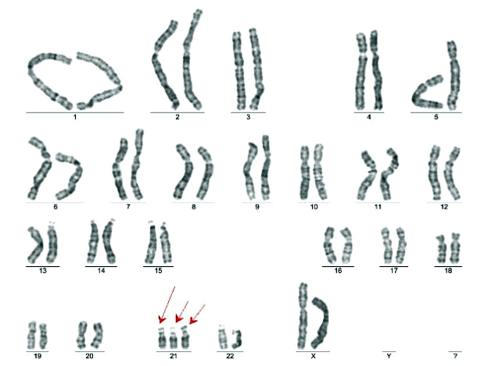
Trisomy of chromosome 21

Slide 212
Try to list at least three advantages of screening with cffDNA testing
Highest sensitivity (99 %)
Lowest false positive rate (0.2 %)
Non-invasive (hence NIPT) – amniocentesis only in case of a positive result
The genetic make-up of the foetus is tested directly, not just the parameter associated with it
The sex of the foetus can also be determined
1. Only one disadvantage – high price

Slide 213
Case report
Hyposideraemic anaemia

Slide 214
Medical history and current disease
Boy, age 3 years 3 months
Birth and further development normal
Accidentally found severe anaemia during a preventive check-up with a paediatrician
In retrospect, the mother reports that the child is sometimes a little tired in the afternoon, the boy has always been paler; he eats normally, including meat
Objective findings normal except for signs of anaemia on mucous membranes

Slide 215
Laboratory tests – red blood count
Method and result |  | Unit
Erythrocytes | 4.50 · 10¹² | l⁻¹
Haemoglobin | 58.0 | g/l
Haematocrit | 0.221
Ery volume (MCV) | 49.1 | fl
Hb ery | 12.9 | pg
Hb conc. | 262 | g/l

Slide 216
Laboratory tests – indicators of iron metabolism
Method and result |  | Normal values | Unit
Iron | < 2.0 | 4 – 19 | µmol/l
Transferrin | 4.14 | 1.5 – 3.3 | g/l
Transferrin saturation | < 1.9 | 20.0 – 50.0 | %
Ferritin | 10 | 30 – 233 | µg/l
sTfR | 60.8 | 2.6 – 6.2 | µg/l

Slide 217
Next procedure – search for the cause
Iron losses were not confirmed
Another possibility is a resorption disorder – an iron resorption curve was performed (5 mg Fe p.o. as Actiferrin drops); the serum iron level was:
after 1 h: 30.5 µmol/l; after 2 h: 52.5 µmol/l
The cause of iron deficiency was in the diet (mother probably wasn't telling the truth)
Child treated with iron p.o. (Actiferrin drops) → gradual improvement of blood count indicators

Slide 218
Laboratory tests – blood count
Already after a week of treatment, a tendency to improve the blood count can be seen
Method | Results
 | 1. 11. | 8. 11.
Erythrocytes | 4.50 · 10¹² | 4.85 · 10¹²
Haemoglobin | 58.0 | 73.0
Haematocrit | 0.221 | 0.279
Ery volume (MCV) | 49.1 | 58.0
Hb ery | 12,9 | 15.1
Hb conc. | 262 | 263

Slide 219
Case report
Pseudohyperkalaemia without haemolysis

Slide 220
Pseudohyperkalaemia without haemolysis
The following results were found in a 78-year-old patient:
Method | 7.00 h
Na⁺ (mmol/l) | 144
K⁺ (mmol/l) | 7.0
Cl⁻ (mmol/l) | 110
Urea (mmol/l) | 8,9
Creatinine (µmol/l) | 109
Haemolysis index | 0

Slide 221
Pseudohyperkalaemia without haemolysis
A new blood sample has been requested:
Method | 7.00 h
Na⁺ (mmol/l) | 144
K⁺ (mmol/l) | 7.0
Cl⁻ (mmol/l) | 110
Urea (mmol/l) | 8.9
Creatinine (µmol/l) | 109
Haemolysis index | 0

Slide 222
Pseudohyperkalaemia without haemolysis
A new recruitment has been requested:
Method | 7.00 h | 10.00 h
Na⁺ (mmol/l) | 144 | 139
K⁺ (mmol/l) | 7.0 | 8.3
Cl⁻ (mmol/l) | 110 | 108
Urea (mmol/l) | 8.9 | -
Creatinine (µmol/l) | 109 | -
Haemolysis index | 0 | 0

Slide 223
Pseudohyperkalaemia without haemolysis
And one more – potassium incompatible with life:
Method | 7.00 h | 10.00 h
Na⁺ (mmol/l) | 144 | 139
K⁺ (mmol/l) | 7.0 | 8.3
Cl⁻ (mmol/l) | 110 | 108
Urea (mmol/l) | 8.9 | -
Creatinine (µmol/l) | 109 | -
Haemolysis index | 0 | 0

Slide 224
Pseudohyperkalemia without haemolysis
And one more – potassium incompatible with life:
Method | 7.00 h | 10.00 h | 14.00 h
Na⁺ (mmol/l) | 144 | 139 | 135
K⁺ (mmol/l) | 7.0 | 8.3 | 12.4
Cl⁻ (mmol/l) | 110 | 108 | 109
Urea (mmol/l) | 8.9 | - | -
Creatinine (µmol/l) | 109 | - | -
Haemolysis index | 0 | 0 | 0

Slide 225
What was the blood cell count?
Method and result |  | Unit
Erythrocytes | 3.46 ∙ 10¹² | l⁻¹
Haemoglobin | 109 | g/l
Leukocytes | 662.9 · 10⁹ | l⁻¹
Platelets | 62 ∙ 10⁹ | l⁻¹
Dg.: Chronic lymphocytic leukaemia
Potassium suspected to be released from tumour leukocytes during transport via tube transport system

Slide 226
Experiment
Method | Method of transport
 | By hand | Pipeline
Na⁺ (mmol/l) | 144 | 129
K⁺ (mmol/l) | 4.5 | 14.1
Cl⁻ (mmol/l) | 110 | 125
Pseudohyperkalaemia originated in leukocytes
Similarly, platelets, if significantly multiplied, can lead to pseudohyperkalaemia in the serum (heparin plasma has normal potassium)

Slide 227
Case report
MetabOlic alkalosis

Slide 228
Medical history and current disease
46-year-old woman, treated for cutaneous psoriasis, no other serious illnesses
She had a gastric balloon inserted endoscopically (BMI 28)
About a week after the procedure intermittent abdominal pain under the left rib arch, later followed by repeated vomiting of gastric juice
She was examined at the surgical clinic of the Faculty Hospital in Pilsen; after exclusion of sudden abdominal attack, she was sent for further examination and treatment to the Ist dept. of internal medicine

Slide 229
Initial laboratory examination – acid-base balance
Method and result |  | Unit
pH | 7.62
pCO₂ | 5.4 | kPa
HCO₃⁻ | 41.7 | mmol/l
BE | 17.9 | mmol/l
Lactate | 1.0 | mmol/l
pO₂ | 11.0 | kPa
Hb saturation | 0.97

Slide 230
What type of AB disorder was present?
Acute metabolic alkalosis
Partially compensated metabolic alkalosis
Fully compensated metabolic alkalosis
Method and result |  | Unit
pH | 7.62
pCO₂ | 5.4 | kPa
HCO₃⁻ | 41.7 | mmol/l
BE | 17.9 | mmol/l
Notes:
1.
AST
0,77
µkat/l
ALT
0,20
µkat/l
ALP
2,7
µkat/l
AMS
7,85
µkat/l
2.
Glucose
41,0
mmol/l
3.
Urea
6,2
mmol/l
4.
Creatinine
118
µmol/l
5.
At⁺
113
mmol/l
K⁺
4,2
mmol/l
Cl⁻
80
mmol/l
6.
Cholesterol
31,0
mmol/l
7.
Triacylglycerols
69,0
mmol/l

Slide 231
Evaluation of acid-base balance (compensation cross)

Slide 232
Other laboratory tests
Method and result |  | Unit
Na⁺ | 121 | mmol/l
K⁺ | 2.5 | mmol/l
Cl⁻ | 63 | mmol/l
Urea | 26.0 | mmol/l
Creatinine | 302 | µmol/l

Slide 233
Mineralogram evaluation
Evident is the presence of hyponatraemia (121 mmol/l), hypokalaemia (2.5 mmol/l) and hypochloridaemia (63 mmol/l)
Which of the mineral values listed above need to be corrected (i.e. are they influenced by other factors)?
Na⁺
K⁺
Cl⁻

Slide 234
Comment to previous question (1)
Sodium is affected by dehydration with the following haemoconcentration; in fact, it would be even lower
Potassium level is affected by alkalaemia
A 0.1 rise in pH leads to a decrease in K⁺ concentration by about 0.6 mmol/l
In our case, the pH should drop from 7.62 to 7.40, i.e. by 0.22 to reach a normal value
This corresponds to an increase in K⁺ of 2.2 × 0.6 = 1.32 mmol/l, to 2.5 + 1.3 = 3.8 mmol/l

Slide 235
Comment to previous question (2)
The chloride concentration should always be correlated with the sodium concentration
We calculate the corrected chloride (i.e., the chloride concentration the patient would have with normal sodium):
Cl⁻_{cor} = Cl⁻_{measured} × Na⁺_{normal} /Na⁺_{measured}
63 × 140/121 = 73 mmol/l
A value of 73 mmol/l still indicates severe hypochloridaemia

Slide 236
Correction of AB disorder by the kidneys
With significant alkalaemia, an alkaline urine reaction would be expected (correction of the disorder by the kidneys)
However, the pH of the urine was acidic – 5.0; this is due to:
Renal function impairment
Hyponatraemia
Hypokalaemia

Slide 237
Comment
This is called paradoxical aciduria: the pH of the urine should be alkaline, yet it is acidic
The cause is hypokalaemia:
in hypovolaemia, the tubules of the kidneys absorb Na⁺ (and with it water) – controls aldosterone
due to electroneutrality, the tubules have to secrete another cation – it cannot be K⁺ (there is not enough of it), so they secrete H⁺; this leads to an acidic urine reaction and further aggravation of alkalaemia
the causal treatment is K⁺ supplementation

Slide 238
Assessment of kidney function
Lab results suggest renal failure
With vomiting and subsequent dehydration, functional renal failure first occurs from hypoperfusion of the renal cortex
Prolonged hypoperfusion leads to renal ischaemia and the development of anatomical changes
Method and result |  | Unit
Urea | 26.0 | mmol/l
Creatinine | 302 | µmol/l
eGF (CKD-EPI) | 0.25 | ml/s

Slide 239
Differentiation between two types of renal failure
Laboratory testing will help differentiate between functional and anatomical failure, i.e. between prerenal and renal failure
The necessary parameters and their results are shown in the table:
Method | Serum | Urine | Unit
Na⁺ | - | 21 | mmol/l
Urea | 26.0 | 234 | mmol/l
Creatinine | 302 | 10 770 | µmol/l
Osmolality | 276 | 422 | mmol/l

Slide 240
What helps distinguish the two types of renal failure
In functional (prerenal) failure, the kidneys are able to absorb Na⁺ (and with it water and produce concentrated urine) and excrete nitrogenous catabolites
In renal failure with anatomical kidney damage, the kidneys are unable to spare Na⁺ and excrete sufficient nitrogenous catabolites, nor are they able to concentrate urine

Slide 241
Prerenal or renal failure?
prerenal
renal
U-Na⁺
20
30
FE_{Na}
0.01
0.03
U-osmolality
400
350
U/S-urea
10
5
U/S-creatinine
20
15
U/S-osmolality
1.1
U-Na⁺ × S-creat./U-creat.
1.5

Slide 242
Comment
The vomiting must have been intense, but it lasted a relatively short time
Because of this, severe metabolic alkalosis and dehydration developed, leading to kidney failure, but still functional
Circulating blood volume needs to be replenished; improvement of renal function can be expected, although serum creatinine is quite elevated

Slide 243
Next procedure – treatment
Rehydration, alimentation (peripheral parenteral nutrition)
Discharged after 8 days of hospitalization
Causal would be to remove the balloon from the stomach, but the patient refuses, so at least the filling was modified
The following table shows the laboratory values before discharge

Slide 244
Laboratory findings at discharge
Method and result
Na⁺ (mmol/l) | 137
K⁺ (mmol/l) | 4.0
Cl⁻ (mmol/l) | 103
Urea (mmol/l) | 3.1
Creatinine (µmol/l) | 42
eGF (ml/s) | > 1.5
pH | 7.45
pCO₂ (kPa) | 5.3
HCO₃⁻ | 27.5
BE (mmol/l) | 3.7

Slide 245
Case report
Exertional rhabdomyolysis

Slide 246
Medical history and current disease
A 28-year-old woman, she's never suffered from any serious disease
After a long break, she trained intensively
The following day muscle pain on lower limbs, palpation tenderness in the right lower epigastrium, temperature 37.4 °C
She was looking at dark urine
Examined at the surgical outpatient clinic, sonographic examination of epigastrium and kidneys normal, sudden abdominal attack ruled out
She was referred to the infectious disease clinic for AST 53.0 μkat/l and ALT 11.3 μkat/l

Slide 247
Diagnosis at the infectious disease outpatient clinic
In the infectious disease outpatient clinic, the condition was assessed as: K679 Hepatopathy of unclear etiology and laboratory examination was completed with the following result:
- serology of hepatitis (A, B, C) negative
- AST 53.0 μkat/l, ALT 11.3 μkat/l
- CK > 360 μkat/l
- myoglobin 5 638 μg/l
- urine: chemically blood 2, in sediment 2 ery/μl

Slide 248
Which statement is true?
Aminotransferases are probably not of hepatic origin
Laboratory tests confirmed hepatopathy
The finding in the urine is clearly indicative of haematuria
Rhabdomyolysis may be the cause of the problem and the finding

Slide 249
Comment to question 1
The aminotransferases were probably derived from skeletal muscle; an AST/ALT ratio > 1 would have to indicate severe liver damage if the enzymes were of hepatic origin.
High CK activity and serum myoglobin concentration are also indicative of a muscular origin.
Chemical blood test in the urine shows haeme; in this case, myoglobin reacted (finding of 2 erythrocytes/μl of urine is normal and cannot cause positive chemical detection of blood).

Slide 250
High concentrations of myoglobin can be toxic to
Myocardium
Tubules of the kidneys
Glomeruli of the kidneys

Slide 251
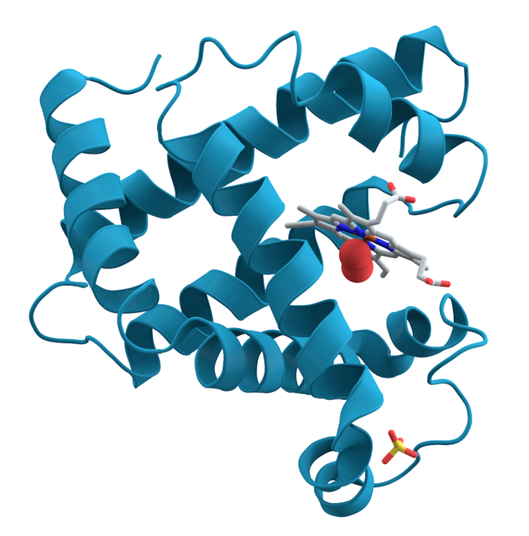
Comment on question 2
Myoglobin has Mr 17.5 kDa.
It therefore passes freely through the glomerulus.
In larger quantities, it can precipitate in the tubules and lead to acute renal failure.
It is necessary to support diuresis, myoglobin solubility improves urine alkalinisation.

Slide 252
Further fate of the patient
This was followed by 5 more checks at the infectious disease clinic.
Status reassessed to: Rhabdomyolysis after excessive physical exertion
Gradually, the laboratory findings normalized.
Renal function was normal throughout the follow-up period.

Slide 253
Case report
Atypical finding in CSF

Slide 254
Finding in cerebrospinal fluid
Method and result |  | Unit
Protein | 0.91 | g/l
Glucose | 1.4 | mmol/l
Lactate | 9.2 | mmol/l
Mononuclei | 470 | µl⁻¹
Polynuclei | 0 | µl⁻¹
What‘s strange about the finding?

Slide 255
Finding in the cerebrospinal fluid
Slightly increased proteinorhachia, multiplied mononuclei – a finding typical for serous (viral) meningitis
But low glucose and high lactate – like in purulent (bacterial) meningitis
The solution comes from the patient's diagnosis: lymphoma
These are immature lymphocytes in CSF
Blood-brain barrier disorder present
Lactate and glucose reflect energy gain in malignant cells by anaerobic glycolysis

Slide 256
And blood cell count
Method and result |  | Unit
Erythrocytes | 3,03 · 10¹² | l⁻¹
Haemoglobin | 92.0 | g/l
Haematocrit | 0.283
Ery volume (MCV) | 92 | fl
Hb ery | 30.2 | pg
Hb conc. | 323 | g/l

Slide 257
What type of anaemia is it?
Sideropenic
Anaemia of chronic diseases
From vitamin B12 deficiency
Iron deficiency is characterized by a small erythrocyte volume with only a slightly reduced erythrocyte count;
In vitamin B12 deficiency there is a large mean erythrocyte volume
The finding is consistent with anaemia of chronic diseases – the main cause is a chronic inflammatory condition with overproduction of hepcidin

